Slide 1
React
Developing a front end with React.

Slide 2
React
React JS uses JavaScript (or typescript).
It can be built a pure JavaScript in a web page.
It can be built using node.js and compiled out as SPA (single page app) With things like JSX.
  Most can be converted to pure JavaScript but then exposes all the code.
It can be build using one of the many (full-stack) frameworks that exist.
  Next.js (one of the most popular, React Router, React Native (which also allows cross-platform development), Gatsby, expo, just to name a few.

Slide 3
React and Virtual DOM Concept.
The Virtual DOM is a lightweight copy of the actual DOM kept
in memory.
How it works:
  When state changes, React creates a new Virtual DOM tree
  React compares the new tree with the previous one (diffing)
  React calculates the minimum number of changes needed
  React updates only the changed parts in the real DOM (reconciliation)
Benefits:
  Improved performance (batch updates)
  Efficient re-rendering
  Cross-platform abstraction
  Predictable updates

Slide 4
Ecosystem overview
Core Libraries:
  React: Core library for building UI components
  ReactDOM: DOM-specific methods for web applications
  React Native: Build native mobile applications
Build Tools:
  Vite: Fast, modern build tool (recommended)
  Create React App: Traditional starter (being phased out)
  Next.js: React framework with SSR/SSG capabilities
  Parcel: Zero-configuration bundler
Routing:
  React Router: Standard routing library
  TanStack Router: Type-safe routing
  Next.js Router: Built-in file-based routing
Development Tools:
  React DevTools: Browser extension for debugging
  ESLint: Code linting
  Prettier: Code formatting
  TypeScript: Static type checking
State Management:
  Context API: Built-in state management
  Redux Toolkit: Predictable state container
  Zustand: Lightweight state management
  Jotai: Primitive and flexible state management
  Recoil: Experimental state management by Meta
Data Fetching:
  TanStack Query (React Query): Powerful data synchronization
  SWR: React hooks for data fetching
  Apollo Client: GraphQL client
  Axios: Promise-based HTTP client
UI Libraries:
  Material-UI (MUI): Comprehensive component library
  Chakra UI: Simple, modular components
  Ant Design: Enterprise-level UI design
  shadcn/ui: Customizable component collection
  Tailwind CSS: Utility-first CSS framework

Slide 5
We will use node.js and Vite
We can build a SPA. Then expose it production just a we did with node.js server.
  npm create vite@latest my-app -- --template react
    for typescript npm create vite@latest my-app -- --template react-ts
  It will start a template app that works. which you can cancel or use
    to start it later, npm run dev --host (-- host exposes outside the machine)
  Once you are happy with it, npm build
    It's now ready as SPA app, to run in node.js as a stand-alone app (or deploy to any cloud server).
  We can also drop this in a web server with minor fixes.
    Routing needs fixed for the web server.
    without routing you can move to anywhere in the webserver, but likely the app assumes it's at / you will need remove / from any references, and everything will work.

Slide 6
VS code
recommended extensions (not required)
  ES7+ React/Redux/React-Native snippets
  ESLint
  Prettier - Code formatter
  Auto Rename Tag
Browser
  React Developer Tools (browser extension)

Slide 7
JSX and react
JavaScript XML is a syntax extension for JavaScript used within React to describe the user interface.
  It resembles HTML syntax
  You embed JavaScript expression with JSX by enclosing them in curly braces {}
  JSX is not directly rendered by the browser, instead it is transpiled (by Babel normally) into React.createElement() calls, which product React elements.
  JSX uses attributes like HTML, but with some differences, such as using className instead of class for CSS classes and htmlFor instead of for labels.
  A JSX expression must always return a single root element. If you need to return multiple elements, you can wrap them in a fragment (<>...</>) or a containing div.

Slide 8
JSX and react (2)
JSX is much stricter than standard HTML
  There must be close tags or self closing
  so <img …> becomes <img … />
  <li>words becomes <li>words</li>
  You can't mix and match, order matters.
    <b> words<i>more</b></i> will cause an error.
  HTML attributes become camelCase in JSX.
    <button onClick={handleClick}>Click</button>
  Inline styles are object with camelCase propertiers
    <div style={{ color: 'red', padding: '10px', backgroundColor: 'blue' }}>
    Inline styled
    </div>
  Comments in JSX, {/* …. */}

Slide 9
React 19 vs 18 and below
There is upgrade and 19 uses newer features. Most AI don't know 19 (yet?). They are producing older out of date code, which may also be security risk.
  to update, npm i react@latest react-dom@latest
In your main.jsx:
// Before
import ReactDOM from 'react-dom';
ReactDOM.render(
<h1>Hello React!</h1>,
document.getElementById('root')
);
// After
import { createRoot } from 'react-dom/client';
createRoot(document.getElementById('root')).render(
<h1>Hello React!</h1>
);

Slide 10
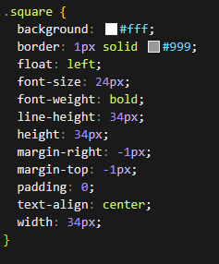
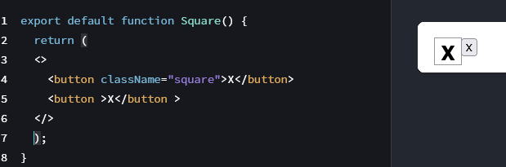
CSS and React.
CSS/style is how you are going to change most elements, color them, etc
  remember JSX uses className, instead of class.
I’m not going to cover CSS with any depth. CSS itself could be many days of lecture, so you can
learn on your own. My examples may not be pretty but should work.

Slide 11
React functions
React components are regular JavaScript functions, but their names must start with a capital letter to work.
  function Square() { return <button>x</button>; };
If like on the previous side, all you markup is not the same line as the return, you MUST have ( ) wrapped around it or the code is ignored.
Also, if you are returning more then one element, you must be wrapped in a <div></div> or fragments <> </>
  return (
  <div>
  <button className="square">X</button>
  <button>X</button>
  </div>
  );

Slide 12
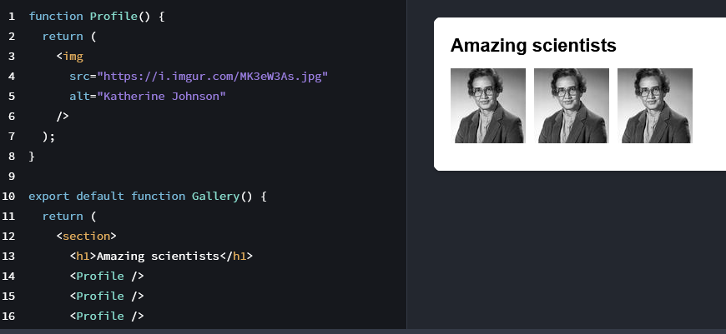
React Functions (2)
When you call a react function, it's uses the <name /> instead of a direct function call

Slide 13
React Functions (3)
Passing data to functions (Props, short for properties) and {}, plus some JS data
function Avatar({person, size}) {
return (
<img
src={person.img}
alt={person.name}
width={size}
height={size}
/> );}
calling it
<Avatar
size={100}
person={{
name: 'Katsuko Saruhashi',
img: 'YfeOqp2'
}}
/>

Slide 14
Object properties and arrays
const person = {
name: 'Alice',
age: 25,
city: 'NYC'
};
return (
<div>
<h1>{person.name}</h1>
<p>Age: {person.age}</p>
<p>City: {person.city}</p>
</div>
);
const numbers = [1, 2, 3, 4, 5];
return (
<div>
<p>Sum: {numbers.reduce((a, b) => a + b, 0)}</p>
<p>Count: {numbers.length}</p>
</div>
);

Slide 15
Expressions only
statement
return (
<div>
{if (condition) { return <p>True</p> }} // ❌ Statement
{for (let i = 0; i < 10; i++) { }} // ❌ Statement
</div>
);
expressions (functional statements only in the return statement)
return (
<div>
{condition && <p>True</p>} // ✅ Expression
{condition ? <p>True</p> : <p>False</p>} // ✅ Expression
{items.map(item => <div key={item.id}>{item.name}</div>)} // ✅ Expression
</div>
);

Slide 16
Fragments
React Fragments are a feature in React that allow you to group multiple elements returned by a component without adding an extra node to the DOM.
  cleaner DOM (ie unnecessary div tags), which helps to not break CSS as well. Also, better performance in rendering
  Sematic HTML, you need to return multiple elements for things like tables and other structures, which div would break the html.
  Fragment is also needed for lists (<dl>, <li> and others), where a key is needed for entry.
    <Fragment key={item.id}> <li> … </Fragment

Slide 17
Components (formally)
What are Components?
  Components are independent, reusable pieces of UI. They accept inputs (props) and return React elements describing what should appear on screen.
Think of components as JavaScript functions:
  Accept inputs (props)
  Return output (JSX)
  Can be reused multiple times
Benefits:
  Reusability
  Separation of concerns
  Easier testing
  Better organization
Must start with capital letter (PascalCase)
Helps React distinguish components from HTML tags
Examples:
function UserProfile() { }
function HomePage() { }
const NavBar = () => { };

Slide 18

Component Files
Convention: One component per file, filename matches component name.
Button.jsx:
  export default function Button() {
  return <button>Click me</button>;
  }
Using:
import Button from './components/Button';
…
function App() {
return <Button />;
}
Note, components directory is a style, not a requirement. same for one component per file.
It's cleaner and easier to debug.

Slide 19
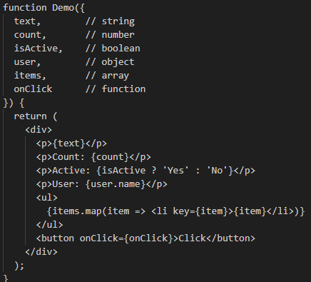
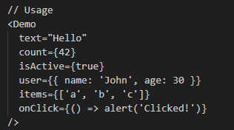
Components and props.
You can then build complex UIs by combining simpler components
use parameters (props) to change the functionality of components.

Slide 20
Components and props (2)
Props are read only, so never modify them.
default Props
function Button({ text = 'Click me', type = 'button' }) {
return <button type={type}>{text}</button>;
}
// Usage
<Button /> // Uses defaults
<Button text="Submit" /> // Custom text
<Button type="submit" /> // Custom type

Slide 21
Components and props (3)
const userProps = {
name: 'John',
age: 30,
email: 'john@example.com'
};
Using the Spread operator
<UserCard {...userProps} />
Same as:
<UserCard name="John" age={30} email="john@example.com" />

Slide 22
"early" Return pattern
Before it was stated, no statements, only expressions. Which is almost true. Not in the return statement, but you can use them before a return statement.
function UserProfile({ user }) {
if (!user) { return <p>No user found</p>; }
if (!user.isActive) { return <p>User is inactive</p>; }
return (
<div>
<h1>{user.name}</h1>
<p>{user.email}</p>
</div>
);
}

Slide 23
State

Slide 24
What is State?
State is private to a component
State changes trigger re-renders (so be careful with state).
Each component instance has its own state
State updates are asynchronous
Never modify state directly
State vs Props:
  Props: Passed from parent, read-only
  State: Managed within component, can be changed

Slide 25
Using state
import useState
declare state
  a variable for the current value
  a setter function
  and initial value
Use the setter function to change state
  remember this triggers a rerender too!
useState can only call it at the top of your component.
And changing state only effects the next Render, not the current render.
import { useState } from 'react';
function Counter() {
const [count, setCount] = useState(0);
return (
<div>
<p>Count: {count}</p>
<button onClick={() => setCount(count + 1)}>
Increment
</button>
</div>
);
}
variable setter initial value

Slide 26
Using state
State variables and initial values can be just about anything, like variables.
  including strings, values, Boolean, arrays, and objects.
  initial values can also be null
const [age, setAge] = useState(42);
  setAge(age + 1); // setAge(42 + 1)
  But remember, state is changed for the next render, not the current,
  setAge(age + 1); // setAge(42 + 1)
  setAge(age + 1); // setAge(42 + 1)
    still would be 43!
updating state and getting the pending state value, you need a function
  setAge(a => a + 1); //setAge(42 => 43)
  setAge(a => a + 1); // setAge(43 => 44)
  setAge(a => a + 1); // setAge(44 => 45)
By convention, it’s common to name the pending state argument for the first letter of the state variable name, like a for age.
  However, you may also call it like prevAge or something else that you find clearer.

Slide 27
State and issues/problems.
initialize is called everytime but only used once. If you have function that is expensive this can cause issues
  const [todos, setTodos] = useState(expesniveFucntion());
  Don't call it, have usestate call
  const [todos, setTodos] = useState(expensiveFucntion); //no param
  const [todos, setTodos] = useState(() => expensiveFucntion()); //function
Common issue: to many re-renders
  <button onClick={setTodos()}>Reset</button> //Wrong calls state function
  <button onClick={setTodos}>Reset</button> //OR CORRECT
  <button onClick={(e) => setTodos(e)}>Reset</button> //for props.
State problems and rerender problems is one of the most common react issues

Slide 28
setting state values, arrays and objects.
Don't change the variable! Use it in the setState method.
setItems([...items, 4]);// Add to end
setItems(items.slice(0, -1)); // Remove last
setItems(items.map(item =>
item === 2 ? 20 : item
)); //update items.
objects
const [user, setUser] = useState({ name: 'John', age: 30});
setUser({ ...user, name: 'Jane' });
setUser({ ...user, name: 'Jane', age: 31 });
const [user, setUser] = useState({ name: 'John',
address: { city: 'NYC', zip: '10001' }});
// Update nested property
setUser({ ...user,
address: { ...user.address, city: 'Boston' }
});

Slide 29
update state from form objects.
const [formData, setFormData] = useState({
id: id,
name: name,
score: score
});
const handleChange = (e) => {
const { name, value } = e.target;
setFormData({
...formData,
[name]: value
});
};
<label>{formData.id}:</label>
<input type="text" name="name" value={formData.name} onChange={handleChange} />
<input type="number" name="score" value={formData.score} onChange={handleChange} />
<button type="submit" onClick={handleSubmit}>Submit</button>
</form>

Slide 30
Components
React supports all built-in brower HTML components
  https://react.dev/reference/react-dom/components
form components <input>, <select>, <textarea> are special, because passing the value prop to them makes them controlled.
  controlled: you need to use state with them.
  const [firstName, setFirstName] = useState(''); // Declare a state variable...
  return (
  <input
  value={firstName} // ...force the input's value to match the state variable...
  onChange={e => setFirstName(e.target.value)} // ... and update the state variable on any edits!
  />
  );
  note, without props, you can use input without state, but you need to use the form component <form action={search}> … //where search takes input
    function search(formData) … formData.get("name of input").

Slide 31
References and resources
https://react.dev/
https://react.dev/learn
https://www.w3schools.com/react/react_jsx.asp
https://react.dev/reference/react-dom/components

Slide 32
Q
A
&

