Slide 1
COSC 5/4735
Firebase and JS.
part 2: storage and messaging.

Slide 2
cloud storage

Slide 3
setup
Cloud Storage for Firebase lets you upload and share user generated content, such as images and video, which allows you to build rich media content into your apps. Your data is stored in a Google Cloud Storage bucket — an exabyte scale object storage solution with high availability and global redundancy. Cloud Storage for Firebase lets you securely upload these files directly from mobile devices and web browsers, handling spotty networks with ease.
  Set authentication and access to your storage area.
const firebaseConfig = { // ... storageBucket: 'BUCKET_NAME' };

Slide 4
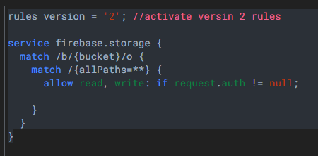
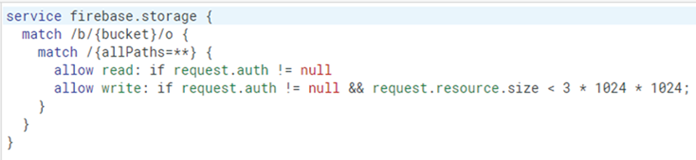
authentication and storage rules.
In you console, you setup permissions to the storage space.
  https://firebase.google.com/docs/storage/security/get-started
  https://firebase.google.com/docs/storage/security/core-syntax
  Also, you likely need to use version 2 rules, not version 1.
Very simple and not secure rules. It requires authentication only, access everything else.
Set max file size per item as well.

Slide 5
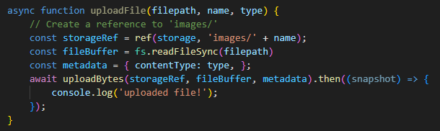

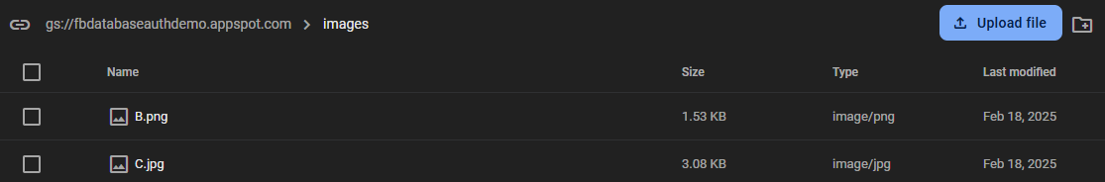
Functions
There are 4 main functions with storage
  upload, download, delete, and list.
for upload
  where to store it, file to upload, and metadata about the file.

Slide 6
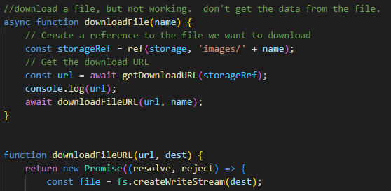
download
The main thing for download, to get a url, then down it with whatever method you choose.
  specify the fullpath, ie directory and file name and then use getDownloadURL to a url. Download with any https code you want.

Slide 7
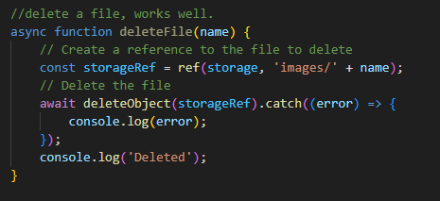
delete
like download, specify the full path to the file (or directory)

Slide 8
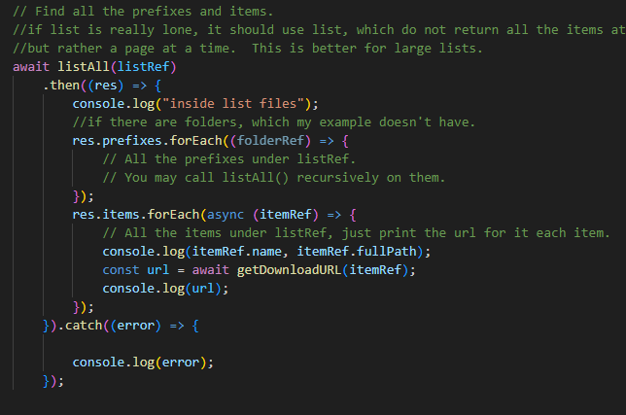
list files or directories.
first thing, the directory doesn't end with / as it does in all the rest of the functions.
to list the images/ directory
  'images'
it returns back folders and items.
  you recursively walk all the directories.
If the directory has a lot of files/directories, just list and page size, then you get page by page to process.

Slide 9
code example.
https://github.com/JimSeker/nodejs/lecture7 in node, doesn't setup a website.
instead, it just uses a fbtest.mjs file
  with init.js, .env and img/ directory to test all the functions.

Slide 10
Cloud messaging

Slide 11
How does it work?
A Firebase Cloud messaging implementation includes two main components for sending and receiving:
  A trusted environment such as Cloud Functions for Firebase or an app server on which to build, target, and send messages.
    This would be our JavaScript Express API server.
  An Apple, Android, or web (JavaScript client side) that receives messages via the corresponding platform-specific transport service.
    I've an android app already working.
    We can also build an app in Flutter to receive these messages later in the course.
    There are directions to build a web app in browser (not node.js)
      https://firebase.google.com/docs/cloud-messaging/js/client
      https://github.com/firebase/quickstart-js/tree/master/messaging

Slide 12
How does it work? (2)
a message can be sent to individual devices, a group of devices, or topics
  each device gets a token.
  you use that device to send an individual.
    as 2023, you send group messages with multiple tokens
    in 2024 that feature was ended, so just lots of single messages.
  The "device" registers to receive messages for "topics".

Slide 13
app sever
JavaScript express ( likely API) with firebase messaging.

Slide 14
app server
The app server job is very simple but very important:
  When a user sends a message from the messaging app (ie ios/android/web app), it sends the message to the app server.
  The server then authenticates with google
  determines where to send it
  Finally, submits it to google for delivery
    Google then delivers the message via their push system to the receiving side.
Our server will also track tokens.
  The client can request username and tokens so client and send individual messages to the username (ie token).

Slide 15
sending messages.
to send a message via google's cloud message
  use POST https://fcm.googleapis.com/v1/projects/myproject-b5ae1/messages:send
    where myproject-b5ae1 is the project name in google console.
    in the header you need an accessToken
    headers: {
    'Authorization': 'Bearer ' + accessToken
    }
    We authenticate and then get an access token for each message sent.
      see the message.js code getAccessToken and header information on getting a accessToken
    build the message and send them via that token.

Slide 16
messages
personal message (ie sending message to a device)
build the json object
{'message': {
'token': Device Token,
'notification': {
'title': "Title of message",
'body': "Body of the message",
}
}

Slide 17
messages (2)
for a topics message
json object:
{ 'message': {
'topic': 'news',
'notification': {
'title': 'FCM Notification',
'body': 'Notification from FCM'
},
"data": {
"Story_id": "story_12345"
}
}
}
Note Data section is completely optional.
it would used in this case to go out and download
story_12345.

Slide 18
subscribing to topics.
For topics, the device needs to be subscribed to the topic
  Sending message then only sends to a topic, not token
    Google will remove invalid topics on their own.
A device can also be unsubscribed to a topic as well.
  In android/ios you can subscribe/unsubscribe via the messaging code
  node, requires firebase-admin module.
    admin module allows with administrative privileges (not fb authentication) a lot of the firebase modules, such as realtime db, firestore, storage, cloud storage, etc
      somethings like remote-config can be configured via node, instead of changing it in console.
    npm install firebase-admin

Slide 19
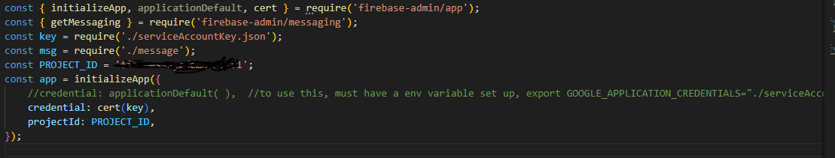
firebase-admin setup
requires a ServiceAccountkey
  then initialize the app and messaging. See code in FcmDemo

Slide 20
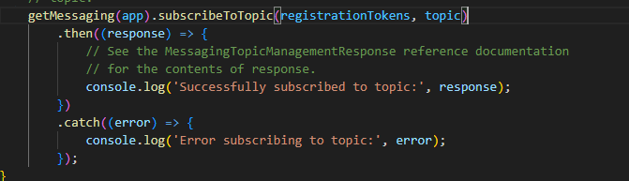
subscribe setup
subscribing to topics,
  array of device tokens, and name of topic (no set names, you make them up)
Now you send a topic message and the device should get it.

Slide 21
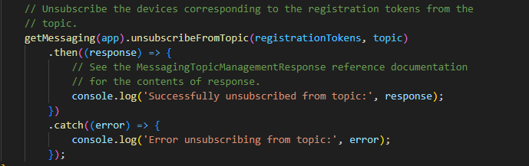
unsubscribing
array of devices, plus the topic.
google will remove invalid devices for you.

Slide 22
notes.
There does not appear to be away to find all the topics
nor who is subscribed to a topic
nor how to delete a topic
  via console, node, or java/Kotlin
if you send to topic that doesn't exist or has no subscriber, it just do anything. no error.
overall topics are a little weird.

Slide 23
References and resources
all example code can be found in the class github repo
  https://github.com/JimSeker/nodejs/FcmDemo
storage
  https://firebase.google.com/docs/storage/security/get-started
  https://firebase.google.com/docs/storage/security/core-syntax
messaging
  https://firebase.google.com/docs/cloud-messaging/js/topic-messaging

Slide 24
Q
A
&

