Slide 1
COSC 5/4735
Firebase and JS.

Slide 2
Firebase
What is it?

Slide 3
What is Firebase
Firebase is Google's client-side app development platform
  based on google could and integrates with most of google tools as well, like ads.
  its multiplatform client for IOS, android, flutter, web (like angular, react, vue) using JavaScript and typescript, ReST, java, Kotlin, swift, objective c, and c++.
It's a collections of almost 20 products that help you build the product google architecture.
They break this products into build and run categories.

Slide 4
Build category.
managed infrastructure
  App Check
    Help protect your backend resources from abuse with Android, iOS, or web providers attesting that incoming traffic is coming from your app.
  App Hosting
    Ship dynamic, full stack apps with the security and scalability of Google Cloud, streamlined deployments from GitHub, and support for modern web frameworks.
  Authentication
    Easily add user authentication for sign-in and onboarding from a variety of providers.
  Cloud Functions
    Write and run app logic server-side without setting up your own server.
  Cloud Storage
    Store and serve user-generated content as your app grows from prototype to production.
  Data Connect
    Connect your app to a Postgres database in CloudSQL with simplified query management tools that make it easy to set up relational data structures.
  Extensions
    Add functionality to your app quickly with pre-packaged, open-source bundles of code to automate common development tasks
  Firestore (new database)
    Build responsive apps with a NoSQL document database that lets you structure data the way you like and retrieve it with expressive queries.
  Firebase ML
    Add machine learning capabilities to your app and deploy custom models that run on-device.
  Genkit
    Build, test, deploy, and securely integrate AI features using an open source framework, local developer tooling, and integrated cloud services.
  Hosting
    Deploy fast-loading, static web apps backed by a global CDN in seconds. (static pages, delivers .html,.css, etc files.)
  Realtime Database (older Database)
    Store and sync data between your users in near-realtime, on or offline, with strong user-based security.

Slide 5
Run Category
launch, monitor and optimize your app
  A/B Testing
    Experiment and test new app features and AI models with a subset of your users to uncover insights to optimize user experience and business outcomes.
  App Distribution
    Distribute pre-release versions of your app to testers to get early feedback on usability.
  Cloud Messaging
    Send targeted, customized, and automated push notifications to re-engage users at no cost.
  Crashlytics
    See real-time crash and error reporting with contextual and AI-driven insights, troubleshooting tips, and clear signals about new releases to help you fix crashes faster.
  Google Analytics
    Monitor app usage and understand user activity so you can deliver personalized experiences.
  In-App Messaging
    Encourage active users to complete key in-app actions with targeted messages. (part of cloud message).
  Performance Monitoring
    Get insight into your app's health and speed from your users' point of view to address latency issues.
  Remote Config
    Fine-tune and gradually roll out server and client side app features, parameters, and models without releasing a new version.
  Test Lab
    Spot errors before release by testing your app on virtual and physical devices that simulate actual usage environments.

Slide 6
Firebase console
Google has several "consoles".
  These are webpages to control varying things.
    Other Examples:
      https://console.cloud.google.com/ google cloud console
      https://console.developers.google.com/apis/ for apis like maps
      https://developers.google.com/beacons/dashboard/ for beacons
Firebase has its own as well.
  https://console.firebase.google.com/

Slide 7

Firebase console (2)
You will need to log into the console
  And setup a project (or use an existing project in the console).
    https://firebase.google.com/docs/web/setup#add-sdk-and-initialize
  We'll initially setup for the Web (JavaScript) but come back later and add Flutter as well. in cosc 4730, we used android.
Remember, this is platform independent.
  Can be used on IoS, Android, Unity, C++ (in IOS or Android), and on the Web as well.

Slide 8
Firebase console (3)
Not all features are supported in all languages.
firebase messaging (receive) is not supported outside of android/ios/chrome.
authentication is not supported in python.
  It appears python, go, c# are being dropped in newer versions
    go and c# were only supported in the admin SDK.
    allowed realtime db read/write but no authentication.
We look at firestore, realtime DB, Authentication, and Storage in JavaScript. In Flutter we come back and look at more.
  Talking about Hosting and cloud functions but both cost $ to even try out now.
    cloud functions used to be free.

Slide 9
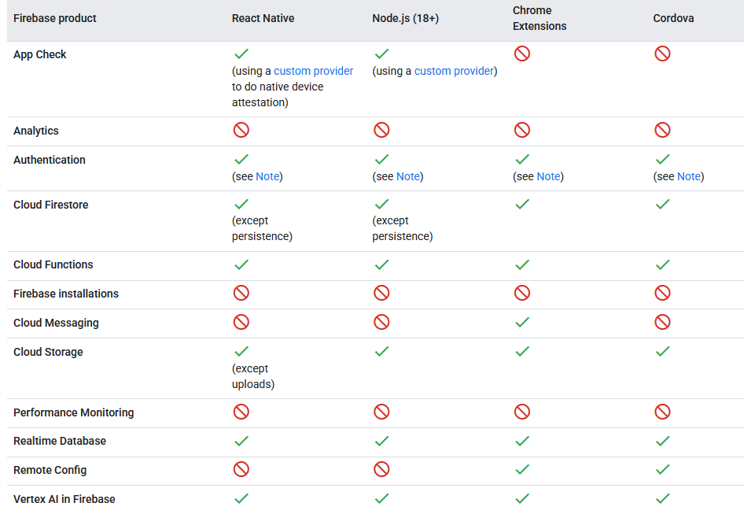
partial listing.

Slide 10
initializing Firebase

Slide 11
For all firebase apps, you
guide to get the config: https://firebase.google.com/docs/web/setup#config-object
export const firebaseConfig = {
//...
};
In my files, it's in the init.js file, which is ignored by .gitignore
then Initialize Firebase in index.js or any other file you need firebase.
const app = initializeApp(firebaseConfig);

Slide 12
Authentication
Firebase

Slide 13
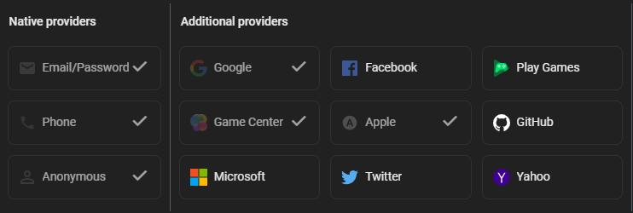
Authentication
Provides method to know a user's identity, plus adds a level of security (depending on the rules you set).
  based on a login, the user can only access "their" section of the database and not read the rest of it.
Firebase Authentication provides backend services, easy-to-use SDKs, and ready-made UI libraries to authenticate users to your app. It supports authentication using passwords, phone numbers, popular federated identity providers like Google, Facebook and Twitter, and more.

Slide 14
Basic authentication email and password.
If the user doesn't have an account already in "your firebase" system
  createUserWithEmailAndPassword(auth, email, password)
    Note you can setup an in the console password security
else use
  signInWithEmailAndPassword(auth, email, password)
    Note, password is plaintext, so your website should have https (mine doesn't). but the firebase connection is supposed to be secure.
Code
  import { getAuth, createUserWithEmailAndPassword, signInWithEmailAndPassword } from "firebase/auth";
  const auth = getAuth(app);

Slide 15
Authentication (2)
There is a pre-built UI to that builds web pages (and other pages for android, IOS, flutter)
  it's a client-side build, so I've skipped it for now.
You can login with google account, facebook account (with api key), apple account (with api key), github, phone number etc.
Most of these require a web or helpful, login. The UI simplifies add authentication and we use it in flutter.
For node.js, I'm going with a simple email/password configuration.

Slide 16
Realtime Database
Firebase

Slide 17
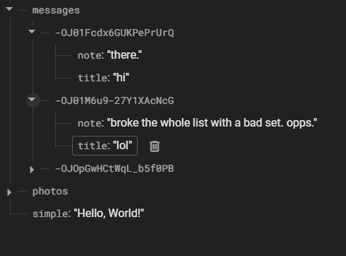
realtime database
Store and sync data with our NoSQL cloud database. Data is synced across all clients in realtime and remains available when your app goes offline.
From the console looking at the
database

Slide 18
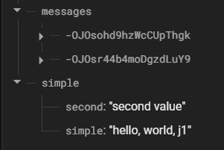
Working a with data.
You need a "reference", you think of as directory.
In this we using simple.
firebase.database().ref('/simple').set({
simple: "hello, world, js",
second: "second value"
});
to update the data, use update, but all the data must be there.

Slide 19
Working a with data (2)
reading it back
firebase.database().ref('/simple').on('value', (snapshot) => {
const data = snapshot.val();
console.log(data.);
});
just prints to console.
data.second has value of second, data.simple has simple's value.

Slide 20
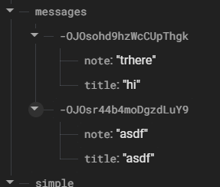
working with lists of data.
Lists, require that each node has a unique id. and realtime can provide you with them by default.
using the push operation, it creates the id
firebase.database().ref('messages/').push()
.set({ //add set the data.
title: title,
note: note,
});
to read, update, or delete, you can now use that unique id number.

Slide 21
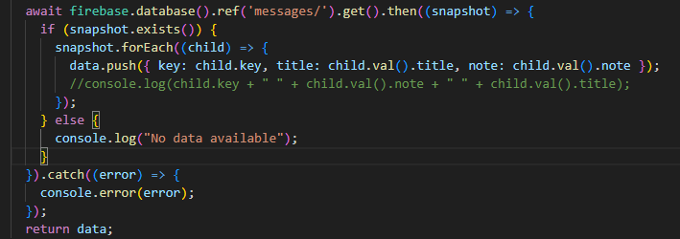
working with lists of data (2)
reading the lists, not just one enter.
the snapshot, returns all the child nodes, you can use the forEach
  key is the id.

Slide 22
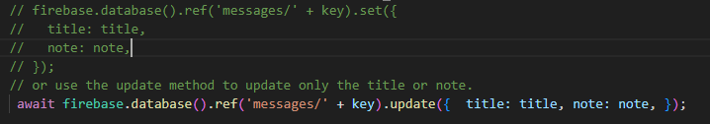

updating and delete
you need the key and the rest is easy.

Slide 23
a note
all this code shows using the web namespace API
  which I think is easier to follow.
but firestore uses the web Modular API version
  the auth is also converted in the example code as well.

Slide 24
cloud FireStore

Slide 25
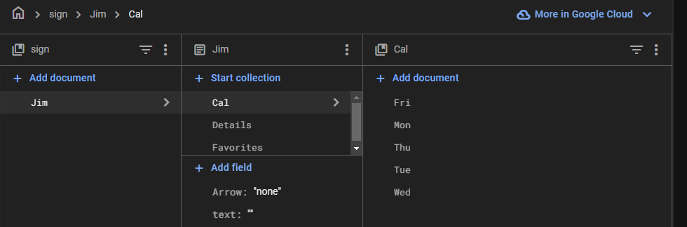
Cloud Firestore
Use our flexible, scalable NoSQL cloud database, built on Google Cloud infrastructure, to store and sync data for client- and server-side development.
google recommends using firestore over realtime db.
  note, you can't use both in a single project.
Instead of a ref and json, firestore is collection, document based
  documents can have collections, and collections can have documents
    up to 64 deep.
    a 3 or 4 deep is likely more then enough.
this tis example, sign is collection, jim is document, then some data, plus more collections of Cal and Favorites.

Slide 26
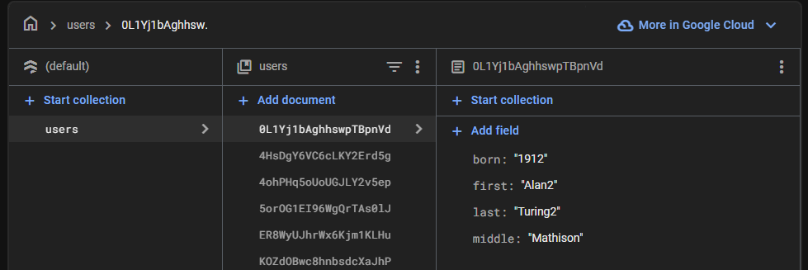
lists as documents
like the real time, you need unique names and firestore can help you.

Slide 27
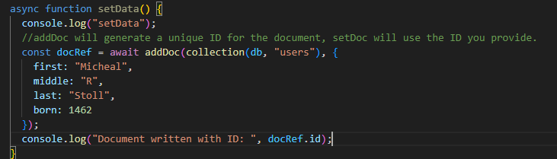
adding list data
the addDoc function gives you an ID.

Slide 28
getting list Data
get a snaphost with all the documents you want
forEach and the doc has the data, id is unique value

Slide 29
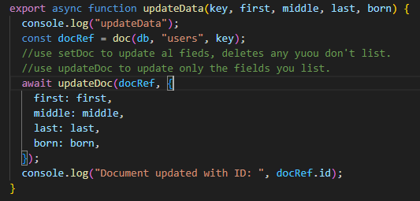
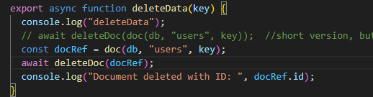
update and delete
like realtime, just need the key

Slide 30
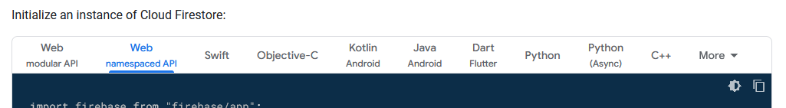
References and resources
all example code can be found in the class github repo
  https://github.com/JimSeker/nodejs/lecture6
authentication
  https://firebase.google.com/docs/auth/web/firebaseui
realtime
  https://firebase.google.com/docs/database/web/start
    has it own web section with examples.
firestore
  https://firebase.google.com/docs/firestore/manage-data/add-data
  All the code for all examples is "mixed together".

Slide 31
Q
A
&

