Slide 1
COSC 5/4735
ReST APIs

Slide 2
What is ReST?

Slide 3
What is ReST?
REST stands for Representational State Transfer.
It is sometimes spelled "REST". but the e is normally lower case.
It relies on a stateless, client-server, cacheable communications protocol -- and in virtually all cases, the HTTP protocol is used.
The idea is that, rather than using complex mechanisms such as CORBA, RPC or SOAP to connect between machines, simple HTTP is used to make calls between machines.

Slide 4
What is ReST? (2)
ReSTful applications use HTTP requests to post data (create and/or update), read data (e.g., make queries), and delete data. Thus, ReST uses HTTP(s) for all four CRUD (Create/Read/Update/Delete) operations.
The returned data maybe some combination of HTML, XML, JSON, etc. Up to the API
There really is no standard.

Slide 5
What is ReST? (2)
The web services may or may not require authentication.
For security, username/password tokens are often used.
For encryption, ReST can be used on top of HTTPS (secure sockets).
Again, depends on the app.

Slide 6
Real world examples
Google’s Mirror API is a ReST API
Flickr
Amazon.com offer several REST services, e.g., for their S3 storage solution
Atom is a ReSTful alternative to RSS,

Slide 7
Standards (not really)
There is only really one standard. It uses a webserver
The request may look like this
http://somewhere.com/posts for all the posts
http://somwhere.com/posts/1 for the first post.
http://somwhere.com/query.php?data=posts for all posts
http://somwhere.com/posts.php?data=posts&num=1 for the first post
The data is returned as csv file, json, xml, or another format.

Slide 8
HTTP and ReST API
A RESTful API typically exposes resources as URLs, and supports a set of operations (called CRUD operations) for interacting with those resources:
Create (POST): Create a new resource.
Read (GET): Retrieve an existing resource.
Update (PUT/PATCH): Update an existing resource.
Delete (DELETE): Remove an existing resource.
Now, let’s move on to building a RESTful API with Express.js.

Slide 9
Implementation

Slide 10
building
To build a ReSTful API with Express and JS
start the project, install express, and all packages you need, etc…
Define the route for your API, specifying the HTTP method (GET, POST, PUT, DELETE), the route URL, and the callback function that handles the request.
You can use something like a router for express, but it's not required.
if you using a browser, the PUT and DELETE won't be available directly.
Implement CRUD operations: Implement the CRUD operations for each route using a database or data storage mechanism.
Test the API
You maybe need create web pages routes to test with or use a tool like Postman to test your API.

Slide 11
Routes for API
GET /products
Retrieves all products.
GET /products/:id
Retrieves a single product by ID.
POST /products
Creates a new product.
all the data in the post.
PUT /products/:id
Updates an existing product by ID.
some data in the post.
DELETE /products/:id
Deletes a product by ID.
If just using a browser with no ajax, you can change the following.
again ,there really isn't a standard.
POST /products/update/:id
Updates an existing product by ID.
some data in the post.
POST /products/delete/:id
Deletes a product by ID.
If you are building on an existing website, you want may use /api/products instead, so you have ones return html
and the api that return data

Slide 12
JSON and Javascript (others)
most languages have a package addon for JSON objects.
javascript it's builtin.
JSON.parse()
Parse a piece of string text as JSON, optionally transforming the produced value and its properties, and return the value.
const jsonString = '{"name":"John","age":30,"city":"New York"}';
const myObject = JSON.parse(jsonString);
console.log(myObject.name);
// Expected output: John
JSON.stringify()
Return a JSON string corresponding to the specified value, optionally including only certain properties or replacing property values in a user-defined manner.
const myObject = { name: "John", age: 30, city: "New York" };
const jsonString = JSON.stringify(myObject);
console.log(jsonString); // Expected output: {"name":"John","age":30,"city":"New York"}

Slide 13
JSON and express.
the Node's low-level res object has json piece as well.
with ReST, we likely not returning HTML, so we can use res.
examples: (req, res) => { //process request, then return info.
successful add example
res.status(201).json({message: 'Item was added'});
failed add example
res.status(500).json({error: 'failed to add item'}); //500 error may cause other problems.
OR (again, you set the return data standard).
res.status(200).json({error:true, message: 'failed to add item'});
res.status(201).json({error:false, message: 'Item was added'});
200 Ok, 201 created, 202 Accepted, 203 Non-authoritative info, 204 no content, 206 partial content (range)

Slide 14
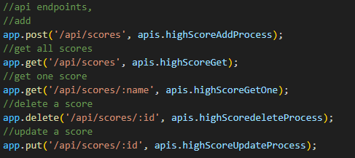
Create the routes

Slide 15
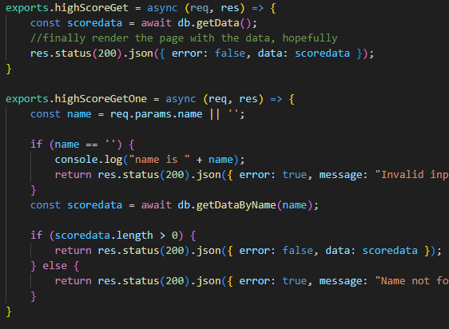
read the data
get all is easy,
just return back all the rows
the json will convert the rows to json arrays.
get One
get path is /api/scores/name
name is req.params, not the body.

Slide 16
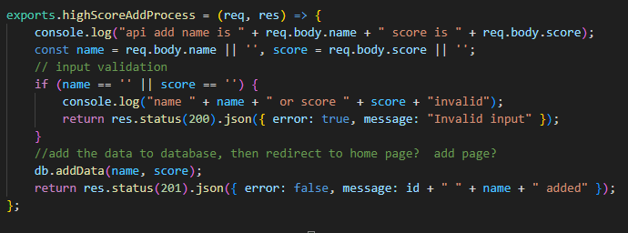
add data
post /api/scores so both name and score is in the body

Slide 17
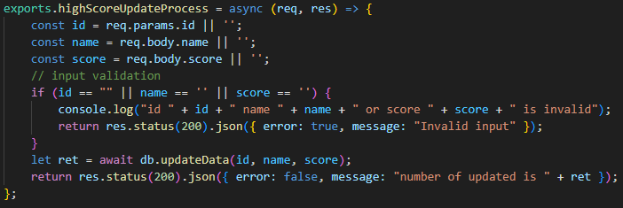
update
put /api/scores/name and score is in the body (ie post)
Also, the db return the number of rows that changed, so we return it.

Slide 18
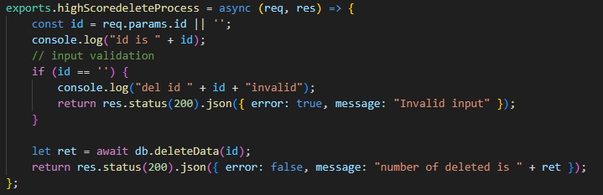
delete
delete /api/scores/name so just get name from params.
again, db returns the number of rows deleted.

Slide 19
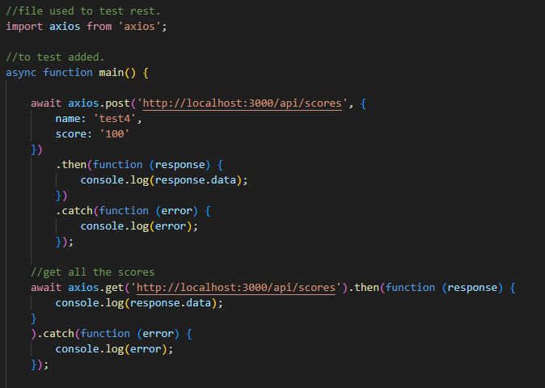
Testing.
If there are no web pages, then you use something like curl.
But I would recommend axios module. It has all the verbs, so you can use js code test and print the output.
In lecture5 see Rtest.mjs file. This is stand-alone file that you run
once the server is running.

Slide 20
Now what?
Now you server can accept information via ReST API requires
these don't require a browser
you can hook up to varying applications and send/receive information.
There is android app to that works with the ReST API
https://github.com/JimSeker/nodejs/RestDemo2

Slide 21
References and resources
all example code can be found in the class github repo
https://github.com/JimSeker/nodejs/lectuer5
https://medium.com/@skhans/building-a-restful-api-with-express-js-a-beginners-guide-dcb1a1e3520d
https://anujdarji100737.medium.com/implementing-restful-routes-with-node-js-and-express-7c47030e591b
https://developer.mozilla.org/en-US/docs/Web/JavaScript/Reference/Global_Objects/JSON
information on router, not used in this lecture.
https://developer.mozilla.org/en-US/docs/Learn_web_development/Extensions/Server-side/Express_Nodejs/routes

Slide 22
Q
A
&

