Slide 1
COSC 5/4735
More Express
handlebars, forms, cookies, and sessions.

Slide 2
The Request and Response Objects
These are the beginning and the end of everything in Express
When building a web server with express, most of what you’ll be doing comes down to these two things
These objects originate in node and are extended by Express
We make a survey of how express works with handlebars, forms, and cookies. But not a lot of depth.

Slide 3
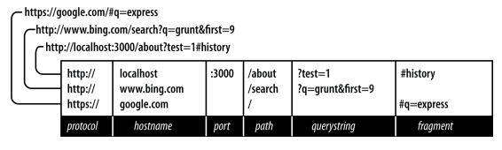
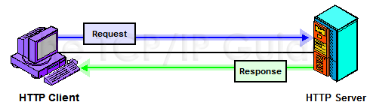
The Parts of a URL
protocol, hostname
and port are about the
host itself. how to connect the server and not about the app.
path is part where your app makes decisions, mostly we have using static or routing.
querystring is optional collection of name/value pairs. It starts with a ? and each pair is separated by ampersands (&)
  URL encoded, means spaces are replaced with plus signs (+) and other replaced with numeric character references
fragment are not passed to the server, the are used browser to determine which section to display.
Notes:
Protocol
The protocol determines how the request will be transmitted. We will be dealing
exclusively with http and https. Other common protocols include file and p.
Host
The host identifies the server. Servers on your computer (localhost) or a local
network may be identified simply be one word or by a numeric IP address. On
the internet, the host will end in a top-level domain (TLD) like .com or .net.
Additionally, there may be subdomains, which prefix the hostname. www is a
common subdomain, though it can be anything. Subdomains are optional.
Port
Each server has a collection of numbered ports. Some port numbers are special,
like 80 and 443. If you omit the port, port 80 is assumed for HTTP and 443 for
HTTPS. In general, if you aren’t using port 80 or 443, you should use a port num‐
ber greater than 1023.
It’s common to use easy-to-remember port numbers like
3000, 8080, and 8088. Only one server can be associated with a given port, and
even though there are plenty of numbers to choose from, you may have to change
the port number if you’re using a commonly used port number.
Path
The path is generally the first part of the URL that your app cares about (it is pos‐
sible to make decisions based on protocol, host, and port, but it’s not good prac‐
tice). The path should be used to uniquely identify pages or other resources in
your app.
Querystring
The querystring is an optional collection of name/value pairs. The querystring
starts with a question mark (?), and name/value pairs are separated by amper‐
sands (&). Both names and values should be URL encoded. JavaScript provides a
built-in function to do that: encodeURIComponent. For example, spaces will be
replaced with plus signs (+). Other special characters will be replaced with
numeric character references. Sometimes the querystring will be referred to as
the search string or simply the search.
Fragment
The fragment (or hash) is not passed to the server at all; it is strictly for use by the
browser. Some single-page applications use the fragment to control application
navigation. Originally, the fragment’s sole purpose was to cause the browser to
display a specific part of the document, marked by an anchor tag (for example: <a
id="chapter06">).

Slide 4
HTTP Request Methods
For a website most pages will respond to GET requests
POST requests are usually reserved for sending information back to the server
  It is common for POST requests to respond with the same HTML as the corresponding GET request
Browsers primarily use the GET and POST method when communicating with a server
The AJAX requests an application makes can use any of the HTTP verbs
With Node and Express you are fully in charge of what verbs can be used
Their verbs are:
  GET, HEAD, POST, PUT, DELETE, CORRECT, OPTIONS, TRACE, PATCH
https://developer.mozilla.org/en-US/docs/Web/HTTP/Methods
Notes:
Post - (form processing, for exam‐
ple).
Also known as HTTP verbs

Slide 5
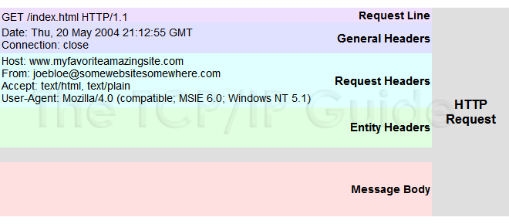
Request Message Example
The browser sends information to the web site
things, like your current browser, OS, and hardware
what your browser can handle and process.
With a Post, the message body has data as well

Slide 6
Response Headers
Severs also sends back information that may not be displayed in the form of headers and metadata
  We’ve seen a content type header, which tells the browser what kind of media is being sent
  All browsers expect a Content-Type header
Headers may also include if the response is compressed or encoding
Headers may also include something regarding how long the browser should cache the files
Response headers also typically contain some information about the server, like what kind it is
  This can also be a security risk to your server.
  It can be disabled by adding app.disable('x-powered-by') to your code

Slide 7
Request Body
In addition to the request headers, a request can have a body
  Normal GET requests don’t have bodies, but POST requests do
  The most common media type for POST bodies is application/x-www-form-urlencoded
  This is simply encoded name/value pairs separated by ampersands
  Essentially, these are of the same format as a query string
If the POST needs to support file uploads, the media type is multipart/form-data
AJAX requests can use application/json
  but not they don't have to, it's just common, the X in AJAX stands are XML.
Notes:
We’ll talk more about bodies in a coming lecture

Slide 8
The Request Object
The request object starts its life as an instance of http.IncomingMessage
  That is a core node object
Express adds further functionality
There are several useful properties and methods for the request object
req.params
req.body
req.route
req.cookies/req.signedcookies
req.headers
req.accepts(types)
req.ip
req.path
req.hostname
req.xhr
req.protocol
req.secure
req.url/req.originalurl
Notes:
The request object (which is passed as the first parameter of a request handler, mean‐
ing you can name it whatever you want; it is common to name it req or request)
req.params
An array containing the named route parameters. We’ll learn more about this in
Chapter 14.
req.query
An object containing querystring parameters (sometimes called GET parameters)
as name/value pairs.
req.body
An object containing POST parameters. It is so named because POST parameters
are passed in the body of the request, not in the URL as querystring parameters
are. To make req.body available, you’ll need middleware that can parse the body
content type, which we will learn about in Chapter 10.
req.route
Information about the currently matched route. This is primarily useful for route
Debugging.
req.cookies/req.signedCookies
Objects containing cookie values passed from the client. See Chapter 9.
req.headers
The request headers received from the client. This is an object whose keys are the
header names and whose values are the header values. Note that this comes from
the underlying http.IncomingMessage object, so you won’t find it listed in the
Express documentation.
req.accepts(types)
A convenience method to determine whether the client accepts a given type or
types (optional types can be a single MIME type, such as application/json, a
comma-delimited list, or an array). This method is of primary interest to those
writing public APIs; it is assumed that browsers will always accept HTML by
default.
req.ip
The IP address of the client.
req.path
The request path (without protocol, host, port, or querystring).
req.hostname
A convenience method that returns the hostname reported by the client. This
information can be spoofed and should not be used for security purposes.
req.xhr
A convenience property that returns true if the request originated from an Ajax
call.
req.protocol
The protocol used in making this request (for our purposes, it will be either http
or https).
req.secure
A convenience property that returns true if the connection is secure. This is
equivalent to req.protocol === 'https'.
req.url/req.originalUrl
A bit of a misnomer, these properties return the path and querystring (they do
not include protocol, host, or port). req.url can be rewritten for internal routing
purposes, but req.originalUrl is designed to remain the original request and
querystring.

Slide 9
Choosing a Template engine
In node there are near limitless choices when selecting a templating engine
There are some primary criteria to be considered when doing so:
Performance
Client, server, both
Abstraction
These are some prominent, many templating engines are mature at this stage
Express allows you to use any templating engine you wish
Notes:
Performance
Clearly, you want your templating engine to be as fast as possible. It’s not some‐
thing you want slowing down your website.
Client, server, or both?
Most, but not all, templating engines are available on both the server and client
sides. If you need to use templates in both realms (and you will), I recommend
you pick something that is equally capable in either capacity.
Abstraction
Do you want something familiar (like normal HTML with curly brackets thrown
in, for example), or do you secretly hate HTML and would love something that
saves you from all those angle brackets? Templating (especially server-side tem‐
plating) gives you some choices here.

Slide 10
The Response Object
The response object starts life as an instance of http.ServerResponse another core node object
Express again adds additional functionality
And again there is a collection of useful; properties and methods
res.status(code)
res.set(name, value)
res.cookie(name, value, [options]),res.clearCookie(name, [options])
res.redirect([status],url)
res.send(body)
res.json(json)
res.jsonp(json)
res.end()
res.type(type)
res.format(object)
res.attachment(...)
res.sendFile(path, [options],[callback])
res.links(links)
res.locals, res.render(view, [locals], callback)
Notes:
The response object (which is passed as the second parameter of a request handler,
meaning you can name it whatever you want; it is common to name it res, resp, or
response)
res.status(code)
Sets the HTTP status code. Express defaults to 200 (OK), so you will have to use
this method to return a status of 404 (Not Found) or 500 (Server Error), or any
other status code you want to use. For redirects (status codes 301, 302, 303, and
307), there is a method redirect, which is preferable. Note that res.status
returns the response object, meaning you can chain calls: res.sta
tus(404).send('Not found').
res.set(name, value)
Sets a response header. This is not something you will normally be doing man‐
ually. You can also set multiple headers at once by passing a single object argu‐
ment whose keys are the header names and whose values are the header values.
res.cookie(name, value, [options]), res.clearCookie(name, [options])
Sets or clears cookies that will be stored on the client. This requires some middle‐
ware support; see Chapter 9.
res.redirect([status], url)
Redirects the browser. The default redirect code is 302 (Found). In general, you
should minimize redirection unless you are permanently moving a page, in
which case you should use the code 301 (Moved Permanently).
res.send(body)
Sends a response to the client. Express defaults to a content type of text/html, so
if you want to change it to text/plain (for example), you’ll have to call
res.type('text/plain’) before calling res.send. If body is an object or an
array, the response is sent as JSON (with the content type being set appropri‐
ately), though if you want to send JSON, I recommend doing so explicitly by call‐
ing res.json instead.
res.json(json)
Sends JSON to the client.
res.jsonp(json)
Sends JSONP to the client.
res.end()
Ends the connection without sending a response. To learn more about the differ‐
ences between res.send, res.json, and res.end, see this article by Tamas Piros.
res.type(type)
A convenience method to set the Content-Type header. This is essentially equiva‐
lent to res.set(\'Content-Type ', type), except that it will also attempt to
map file extensions to an internet media type if you provide a string without a
slash in it. For example, res.type(\'txt ') will result in a Content-Type of
text/plain. There are areas where this functionality could be useful (for exam‐
ple, automatically serving disparate multimedia files), but in general, you should
avoid it in favor of explicitly setting the correct internet media type.
res.format(object)
This method allows you to send different content depending on the Accept
request header. This is of primary use in APIs, and we will discuss this more in
Chapter 15. Here’s a simple example: res.format({'text/plain': 'hi there',
'text/html': '<b>hi there</b>'}).
res.attachment([filename]), res.download(path, [filename], [callback])
Both of these methods set a response header called Content-Disposition to
attachment; this will prompt the browser to download the content instead of dis‐
playing it in a browser. You may specify filename as a hint to the browser. With
res.download, you can specify the file to download, whereas res.attachment
just sets the header; you still have to send content to the client.
res.sendFile(path, [options], [callback])
This method will read a file specified by path and send its contents to the client.
There should be little need for this method; it’s easier to use the static middle‐
ware and put files you want available to the client in the public directory. How‐
ever, if you want to have a different resource served from the same URL
depending on some condition, this method could come in handy.
res.links(links)
Sets the Links response header. This is a specialized header that has little use in
most applications.
res.locals, res.render(view, [locals], callback)
res.locals is an object containing default context for rendering views. res.ren
der will render a view using the configured templating engine (the locals
parameter to res.render shouldn’t be confused with res.locals: it will override
the context in res.locals, but context not overridden will still be available).
Note that res.render will default to a response code of 200; use res.status to
specify a different response code.

Slide 11
Templating with Handlebars
Templating can be best described for form letters. There are spots that get filled with the data, while the rest is the same.
While server-side templating is quickly being supplemented by frontend frameworks like React it still has applications
  it also prevents the users from being able to see all the information, since server side, just gives them a page.

Slide 12
Templating with Handlebars
The problem boils down to this: switch context is problematic
If you’re writing JS it can be annoying to mix in HTML
Having JS emit HTML has problems:
Constantly worry about characters to be escaped
Using JS to generate HTML including JS is… silly
Usually this results in a loss of syntax highlighting
Harder to spot malformed HTML
Code is visually hard to parse

Slide 13
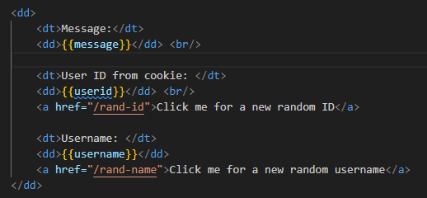
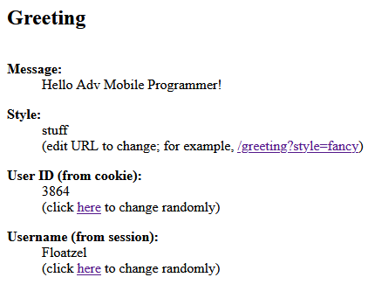
Templating with Handlebars
Templating solves those problems by allowing you to write in the target language
While at the same time providing the ability to insert dynamic data, as we saw last time.

Slide 14
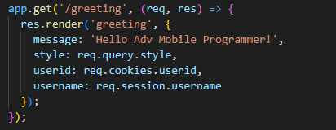
Rendering Content
When rendering res.render is most often used as we have already seen
greetings.js code snippet to right
This renders with handlebars, plus add extra content we get to later, like cookies and sessions
it can also process a querystring variable called style.
We can do things like passing context to a view
  best to look at this in code, then in powerpoint. to many different files.
  greeting.js, views/greeting.handlebars, and views/layout/main.handlebars

Slide 15
Handlebars Basics
Handlebars is an extension of Mustache
Handlebars has easy JS integration, on both the front and backend
They key to understanding templating is the concept of context
When you render a template, you pass the templating engine an object called the context object
This context object allows replacements to work

Slide 16
Handlebars Basics
For example you can have this context object:
With a corresponding template:
Then {{message}} will be replaced with ‘hi class!”
But what if you want to pass HTML instead?
To do so you would need to change the template to be:
Then, HTML can be supplied in the context object

Slide 17
Comments
There is a difference between HTML and handlebars comments
You can still use <!-- html comment -->
Or you can use {{! Handlebars comments}}
IF this is a server side template the Handlebars comment won’t be sent to the client, but the HTML comment will still be sent
Default to Handlebars comments for things you don’t want shared out

Slide 18
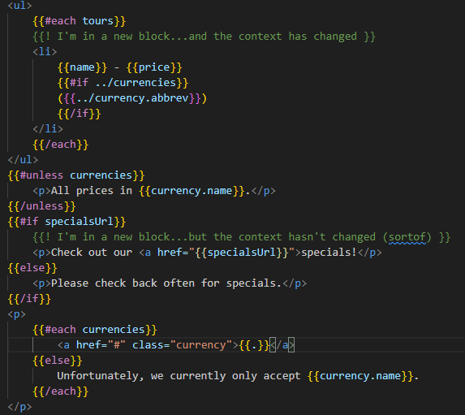
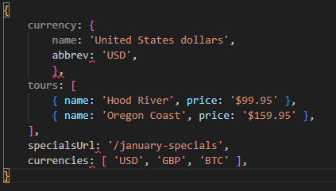
Blocks
Blocks are the next level of complication
Blocks provide flow control, conditional execution, and extensibility

Slide 19
Blocks
There is a lot happening in this template, so we can break it down
It starts with the each helper, that iterates over an array
Between `{{#each tours}}` and `{{/each tours}}` the context changes
On first pass it is `{ name: ‘Hood River’, price: ‘$99.95’}
Then it changes to `{ name: ‘Oregon Coast’, price: ‘$159.95’}

Slide 20
Blocks
If we want to access the currency object `../` is needed to access the parent context
If the property of the context is itself an object, we can access its properties as normal with a period

Slide 21
Blocks
Both `if` and `each` have an option `else` block
There is also an `unless` helper function
This is akin to a negated if statement
This template uses `{{.}}` in the `{{#each currencies}}` block
`{{.}}` refers to the current context
Notes:
(with each, if there are no elements in
the array, the else block will execute).
Accessing the current context with a lone period has another use: it
can distinguish helpers (which we’ll learn about soon) from prop‐
erties of the current context. For example, if you have a helper
called foo and a property in the current context called foo, {{foo}}
refers to the helper, and {{./foo}} refers to the property.

Slide 22
Views and Layouts
A view usually represents an individual page on a website
It can also represent an AJAX-loaded portion of a page
Express looks for views in a views directory
A layout is a special kind of view, essentially a template for templates
Layouts are essential because mosty pages will have a consistent layout
Layouts include a space for the views to be put
you can include sections and even partials. We don't have the time for the depth needed here. But if you are interested: https://www.npmjs.com/package/express-handlebars

Slide 23
Forms

Slide 24
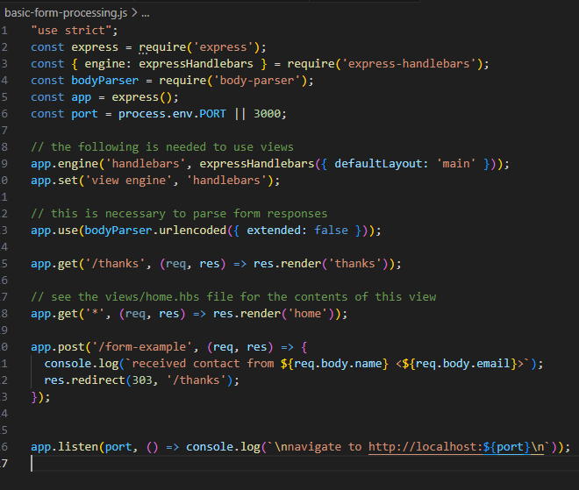
Processing Forms
When processing a form, the information is typically in req.body
To best parse the body, we need some middleware called bodyparser
  req.xhr can be used to determine if it was an AJAX request or a browser request
basic-form-processing.js, plus views/home.handlebars and thanks.handlebars
Notes:
Show basic-form.js

Slide 25
Form Handling
Forms are the usual way to collect information from users in HTML
Forms can be submitted normally through the browser, done via AJAX, or other "fancy front end control" (ie react.js web app or a flutter app.).
Regardless of the choice the underlying technology is still an html form
We’ll talk about:
  Creating forms
  Handling forms
  Form validation

Slide 26
Sending Data From Client to Server
Speaking in general terms there are two options for sending client data to a server
  Querystring Using a GET request
  Request Body Using a POST request.
There is a misconception that POST is secure whereas GET isn’t
In general, if HTTPS is used then both are secure
  If not, an intruder can look at the body data from POST just as easily as their querystring
  If using GET users will see all their input in the querystring and on many systems, the entire querystring will be logged on the server as well.
    Which does make for security questions.

Slide 27
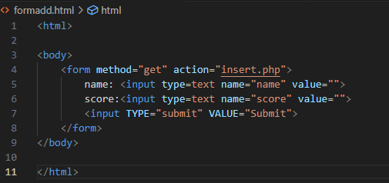

HTML Forms
Forms have been around for a very long time and are nothing new. Most just look prettier then used too. CSS and div tags have helped a lot. But the basic function is unchanged.

Slide 28
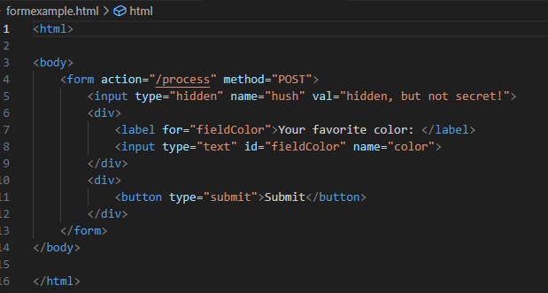

HTML Forms (2)
the important attributes in the <input> fields are the name how the server identifies the field
The name attribute is distinct from the id attribute
  The id attribute is for styling and frontend
the hidden field, this won’t be displayed but it shouldn’t be used for sensitive information
  It's easy seen with page source.

Slide 29
HTML Forms (3)
All forms should be kept logically consistent
A form should contain all the fields you want submitted at once (including optional)
Don’t include any fields you don’t want submitted
When a form is submitted it must be encoded in some fashion
  If you don’t specify an encoding it defaults to application/x-www-form-urlencoded
  This is a basic coding, that Express can handle by default
If you have two different actions on a page, use two different forms

Slide 30
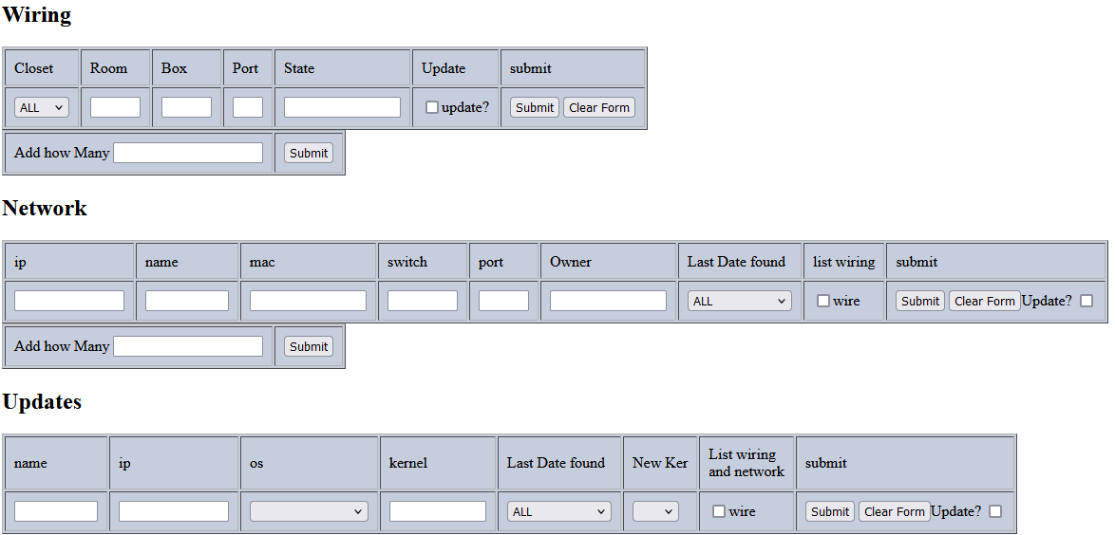
HTML Forms (4)

Slide 31
Different Approaches to Form Handling
Once the "user" hits submit, now how your program handles it
There are couple of ways the data maybe submitted as well.
  Traditional web browser, you selected GET or POST in the form
  AJAX submission, which can use more VERBS.
  Other, such applications using your server as REST API service.
    most of the time with either GET or POST.
There are two things to consider when processing forms:
  What path handles the form
  What response is sent to the browser
    HTML response
    302 or 303 redirect. 303 is recommended
    success/failure pages (may or may not) be HTML response
    original location with a message
    new location with a message.

Slide 32

Form Handling with Express
If using GET for form handling, fields will be available on the req.query object
  If you have an HTML input field with a name attribute email, its value will be passed to a handler in req.query.email
If using POST, you will need to install a middleware to parse the URL-encoded body
  The recommended one is body-parser , once installed it can be used in your project , then req.query will be available from POST

Slide 33
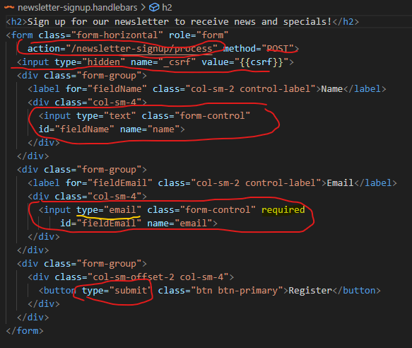
Form processing
From the book, we have this signup form via POST.
  name field
  _csrf which is hidden field.
  email field, that is required. The browser will help us here.
    Note, don't count it on, as a browser may ignore or user could submit another way.
  submit button.
req.query.email and req.query.name should be available in the processing.

Slide 34
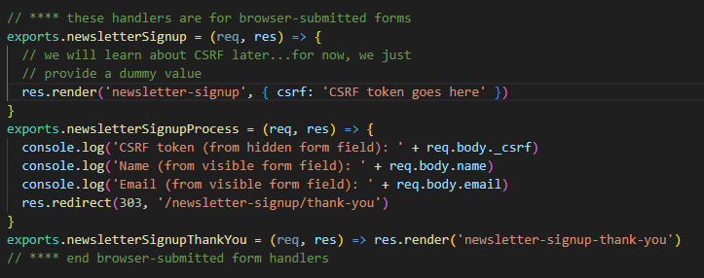
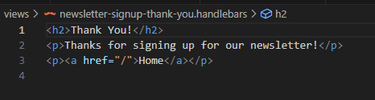
Form processing (2)
The code here is very simple
it's print to the console the 3 fields.
And redirects to a new page
Note, a redirect is not required, you could just put html here, but that breaks the idea of handlebars and page reuse.

Slide 35
Now what?
We have the form data, Now what?
  only in this example would you print it to the console and do nothing else with it.
options
  enter/update the data into persistence storage, ie databases or files
  The pages become very dynamic as the user is using your site to search for information, based on what they entered.
  We customize the user experience immediately, with session or cookies.
    Some pages offer light or dark modes for example.
    Use the clients name or login information
it's up to you.
We have only the essentials of building a website, so you can get the idea of how API services work.

Slide 36
Providing an API
When providing an API the parameters will often be in req.query but req.body can be used too
APIs are different, in that they will often be returning JSON, XML, or plain text rather than HTML
In addition, they may use less common HTTP methods
We delve in APIs and developing them more in the API lecture.

Slide 37
Cookies and Sessions

Slide 38
Cookies and Sessions
Now, we can learn how to use cookies and sessions to provide a better experience for users
This is done by remembering their preferences from page to page, and even between browser sessions
  HTTP is a stateless protocol
  When you load a page in the browser and navigate to a different page within the website neither the server nor the browser have any intrinsic way to understand its the same session
  Every HTTP request contains all the information necessary for the server to satisfy the request
  This is a problem, if the story ended here users could never login to anything and websites wouldn’t remember settings between sessions

Slide 39
Cookies and Sessions
The idea of a cookie is simple:
The server sends a bit of information
The browser stores it for some period
It is up to the server what the particular bit of information is
Often it is a unique ID number that identifies a specific browser it create an illusion of state

Slide 40
Cookies and Sessions
There are some important notes on cookies:
Cookies are not secret from the user
The user can delete or disallow cookies
Regular cookies can be tampered with
Cookies can be used for attacks
Users will notice if you abuse cookies
Prefer sessions over cookies
Notes:
Cookies are not secret from the user
All cookies that the server sends to the client are available for the client to look at.
There’s no reason you can’t send something encrypted to protect its contents, but
there’s seldom any need for this (at least if you’re not doing anything nefarious!).
Signed cookies, which we’ll discuss in a bit, can obfuscate the contents of the
cookie, but this is in no way cryptographically secure from prying eyes.
e user can delete or disallow cookies
Users have full control over cookies, and browsers make it possible to delete
cookies in bulk or individually. Unless you’re up to no good, there’s no real rea‐
son for users to do this, but it is useful during testing. Users can also disallow
cookies, which is more problematic because only the simplest web applications
can make do without cookies.
Regular cookies can be tampered with
Whenever a browser makes a request of your server that has an associated cookie
and you blindly trust the contents of that cookie, you are opening yourself up for
attack. The height of foolishness, for example, would be to execute code con‐
tained in a cookie. To ensure cookies aren’t tampered with, use signed cookies.
Cookies can be used for attacks
A category of attacks called cross-site scripting (XSS) attacks has sprung up in
recent years. One technique of XSS attacks involves malicious JavaScript modify‐
ing the contents of cookies. This is an additional reason not to trust the contents
of cookies that come back to your server. Using signed cookies helps (tampering
will be evident in a signed cookie whether the user or malicious JavaScript modi‐
fied it), and there’s also a setting that specifies that cookies are to be modified
only by the server. These cookies can be limited in usefulness, but they are cer‐
tainly safer.
Users will notice if you abuse cookies
If you set a lot of cookies on your users’ computers or store a lot of data, it will
irritate your users, which is something you should avoid. Try to keep your use of
cookies to a minimum.
Prefer sessions over cookies
For the most part, you can use sessions to maintain state, and it’s generally wise to
do so. It’s easier, you don’t have to worry about abusing your users’ storage, and it
can be more secure. Sessions rely on cookies, of course, but with sessions,
Express will be doing the heavy lifting for you.

Slide 41
Externalizing Credentials
To make cookies secure a cookie secret is necessary
The cookie secret is a string that’s known to the suer and used to encrypt secure cookies
It’s not the password that needs to be remembered, so it can be a random string
It is a common practice to externalize third-party credentials, such as the cookie secret, database passwords, and API tokens
Put these all in the .env file, which is already omitted in .gitignore file, so you won't accidentally make them public.

Slide 42
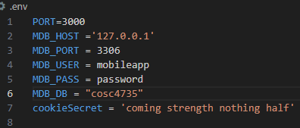

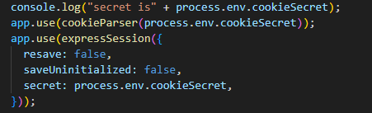
Externalizing Credentials
Using .env file shown here and then dotenv module.
all those variable are now available in process.env. name
so process.env.cookieSecret holds string to encrypt our cookies.

Slide 43


Cookies in Express
Before you start setting and accessing cookies in an app, the cookie-parser middleware is needed
It needs to be installed with npm, included in the code, and the app needs to be told to use it
After that has been done a cookie can be set or signed wherever you have access to the res object
And the value can be retrieved through the `req` object
Finally, they can also be deleted
Notes:
Signed cookies take precedence over unsigned cookies. If you name
your signed cookie signed_monster, you cannot have an unsigned
cookie with the same name (it will come back as undefined).

Slide 44
Cookies in Express
When you set a cookie you can specify the following options:
domain
path
maxAge
secure
httpOnly
signed
Notes:
domain
Controls the domains the cookie is associated with; this allows you to assign
cookies to specific subdomains. Note that you cannot set a cookie for a different
domain than the server is running on; it will simply do nothing.
path
Controls the path this cookie applies to. Note that paths have an implicit wildcard
after them; if you use a path of / (the default), it will apply to all pages on your
site. If you use a path of /foo, it will apply to the paths /foo, /foo/bar, etc.
maxAge
Specifies how long the client should keep the cookie before deleting it, in milli‐
seconds. If you omit this, the cookie will be deleted when you close your browser.
(You can also specify a date for expiration with the expires option, but the syn‐
tax is frustrating. I recommend using maxAge.)
secure
Specifies that this cookie will be sent only over a secure (HTTPS) connection.
httpOnly
Setting this to true specifies the cookie will be modified only by the server. That
is, client-side JavaScript cannot modify it. This helps prevent XSS attacks.
signed
Setting this to true signs this cookie, making it available in res.signedCookies
instead of res.cookies. Signed cookies that have been tampered with will be
rejected by the server, and the cookie value will be reset to its original value.

Slide 45
Sessions
Sessions are a more convenient way to maintain state
To Implement sessions something has to be stored on the client
Otherwise, the server wouldn’t be able to identify the client from one request to the next
The usual method is a cookie that contains a unique identifier
The server then uses that identifier to retrieve appropriate session information
Cookies aren’t the only way to accomplish this
HTML5 provides another option for sessions, called local storage
This offers an advantage over cookies if you need to store a lot of data
  https://developer.mozilla.org/en-US/docs/Web/API/Window/localStorage

Slide 46
Sessions
There are two ways to implement sessions:
Store everything in the cookie
Store only the unique identifier and everything else on the server
The former are called cookie-based sessions
However it still means that everything you add to a session will be stored in a client’s browser, which isn’t great

Slide 47
Common Middleware
Here is a list of common examples:
basicauth-middleware
body-parser
busboy, multiparty, formidable, multer
compression
cookie-parser
cookie-session
Express-session
csurf
serve-index
errorHandling
server-favicon
morgan
method-override
response-time
static
vhost
Middleware gets many modules to a lot of work for us, instead having to write on our won. the body-parser, cookie-parser and session are very coming.
Notes:
basicauth-middleware
Provides basic access authorization. Keep in mind that basic auth offers only the
most basic security, and you should use basic auth only over HTTPS (otherwise,
usernames and passwords are transmitted in the clear). You should use basic auth
only when you need something quick and easy and you’re using HTTPS.
body-parser
Provides parsing for HTTP request bodies. Provides middleware for parsing both
URL-encoded and JSON-encoded bodies, as well as others.
busboy, multiparty, formidable, multer
All of these middleware options parse request bodies encoded with multipart/
form-data.
compression
Compresses response data with gzip or deflate. This is a good thing, and your
users will thank you, especially those on slow or mobile connections. It should be
linked in early, before any middleware that might send a response. The only thing
that I recommend linking in before compress is debugging or logging middle‐
ware (which do not send responses). Note that in most production environ‐
ments, compression is handled by a proxy like NGINX, making this middleware
unnecessary.
cookie-parser
Provides cookie support. See Chapter 9.
cookie-session
Provides cookie-storage session support. I do not generally recommend this
approach to sessions. It must be linked in after cookie-parser. See Chapter 9.
express-session
Provides session ID (stored in a cookie) session support. Defaults to a memory
store, which is not suitable for production and can be configured to use a data‐
base store. See Chapter 9 and Chapter 13.
csurf
Provides protection against cross-site request forgery (CSRF) attacks. This uses
sessions, so it must be linked in after express-session middleware. Unfortu‐
nately, simply linking in this middleware does not magically protect against
CSRF attacks; see Chapter 18 for more information.
serve-index
Provides directory listing support for static files. There is no need to include this
middleware unless you specifically need directory listing.
errorhandler
Provides stack traces and error messages to the client. I do not recommend link‐
ing this in on a production server, as it exposes implementation details, which
can have security or privacy consequences. See Chapter 20 for more information.
serve-favicon
Serves the favicon (the icon that appears in the title bar of your browser). This is
not strictly necessary; you can simply put a favicon.ico in the root of your static
directory, but this middleware can improve performance. If you use it, it should
be linked in high in the middleware stack. It also allows you to designate a file‐
name other than favicon.ico.
morgan
Provides automated logging support; all requests will be logged. See Chapter 20
for more information.
method-override
Provides support for the x-http-method-override request header, which allows
browsers to “fake” using HTTP methods other than GET and POST. This can be
useful for debugging. This is needed only if you’re writing APIs.
response-time
Adds the X-Response-Time header to the response, providing the response time
in milliseconds. You usually don’t need this middleware unless you are doing per‐
formance tuning.
static
Provides support for serving static (public) files. You can link in this middleware
multiple times, specifying different directories. See Chapter 17 for more details.
vhost
Virtual hosts (vhosts), a term borrowed from Apache, makes subdomains easier
to manage in Express. See Chapter 14 for more information.i

Slide 48
References and resources
this lecture heavily references the Web Development with Node and Express, Chapter 4-8,
all example code can be found in the class github repo
  https://github.com/JimSeker/nodejs/lectuer3

Slide 49
Q
A
&

