Slide 1
Cosc 4735
flutter
Navigation bar and rail
bottom app bar and page view.

Slide 2
Scaffold
The Scaffold is key for most of the routing.
  As we have seen, there is built-in
    floatingActionButton:, drawer: and endDrawer:
  There is also BottomNavigationBar and bottomSheet
    The BottomNavigationBar can be used for multiple widgets
    we won't cover the bottomSheet here.

Slide 3
Navigation Bar

Slide 4
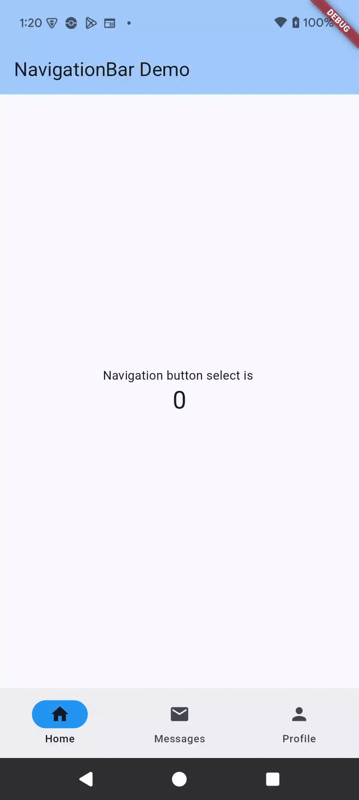
NavigationBar
use the scaffold bottomNavigationBar:
NavgiationBar widget
which takes an array of NavigationDestinations
  takes Icon and label
selectedIndex and OnDestinationSelected method.
From the NaviagationBar Demo

Slide 5
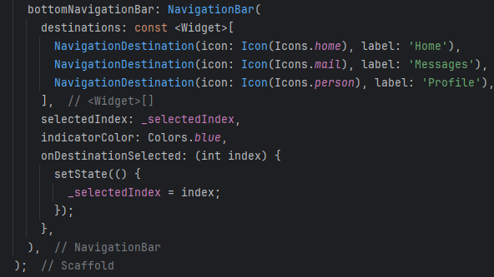
Bottom Navigation (2)
NavBar is supposed to be no more then 5, with 3 being the optimal number of icons
  again, don't forget you can use badges as needed.
A note, this looks good on a say a phone in portrait mode
  but not landscape or web, which the bar takes a lot of space.

Slide 6
Navigation Rail

Slide 7
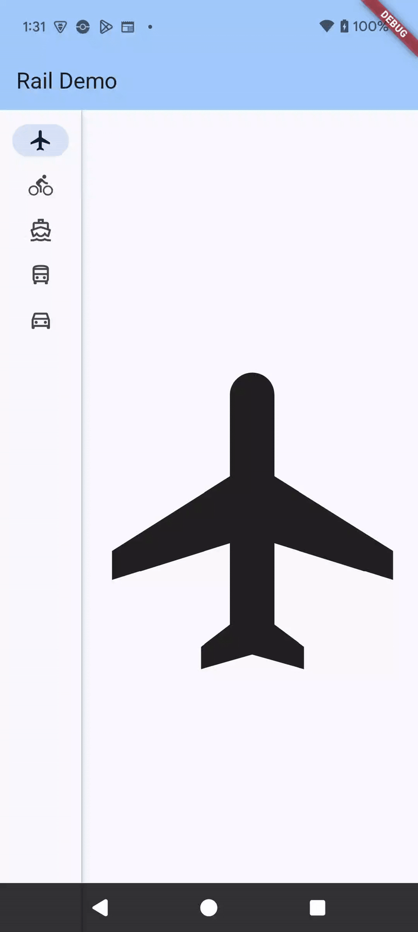
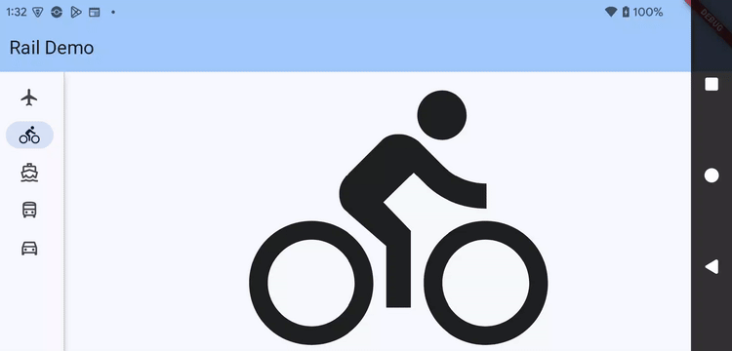
NavigationRail
A Rail is meant for layouts with wide viewports, like web or landscape/tablets.
It allows the maximum space
  unlike a navigationBar, there is no built-in scaffold (yet?).
Body: Row()
  since we want have it on the right (or left), then a divider, then the main widget.

Slide 8
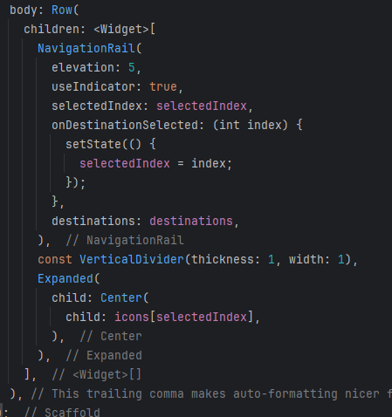
NavigationRail (2)
First is Row, with a NavigationRail
  the rail has lots of optins, like elevation,
  2 needed, selectedIndex and onDestinationSelected
    like NavigationBar
  destinations: is an array of NavigationRailDestination widgets.
Then the divider
and finally, the rest of the widgets
  in our case, just icons.

Slide 9
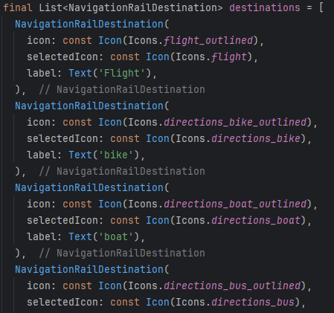
NavigationRailDestination
A variable was used to simply how the code looked; otherwise, this could have been in the destination section of Rail.
  The widget requires both icon and label
  selectedIcon is optional
    if you skip the selectedIndex, then skip selectedIcon as well.

Slide 10

why not both?

Slide 11
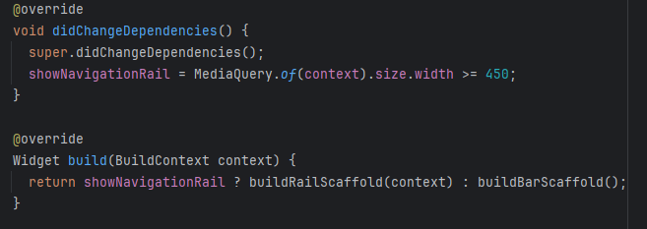
Combined: NavBar and Rail
It maybe better to combine the two, using a width to determine if you show the NavigationRail, otherwise show NavigationBar.
create two methods, one that builds a rail and one that builds a Bar
  each call a "buildMainWidget" for rest of the code.

Slide 12
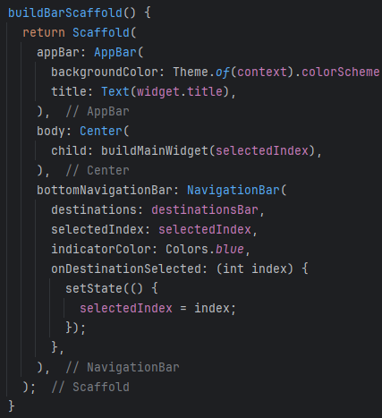
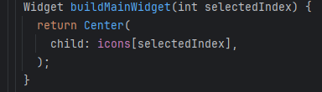
Combined: NavBar and Rail
Each builds the correct one
call buildMainWidget with the correct index.
  note, buildMainWidget is my method name, not a required name.

Slide 13
lastly
one code base looks good on portrait mode
and landscape, plus web and windows/linux.

Slide 14
PageView

Slide 15
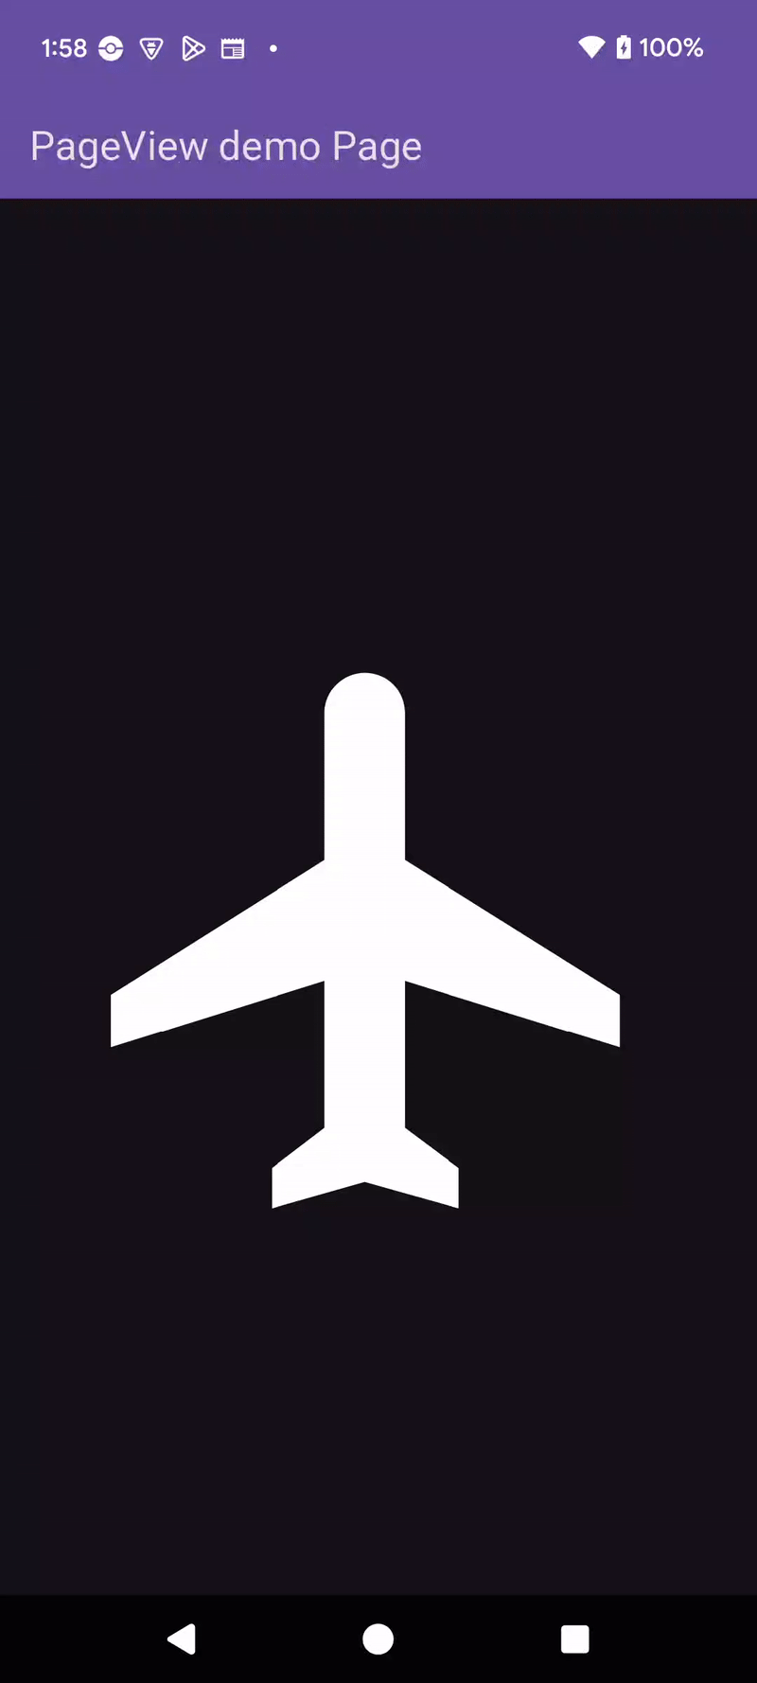
PageView
The PageView provides a swipeable set of widgets, like the Tab, but no headers.
  in Android this would be Pager for fragments.
Note, web doesn't provide swipe well.

Slide 16
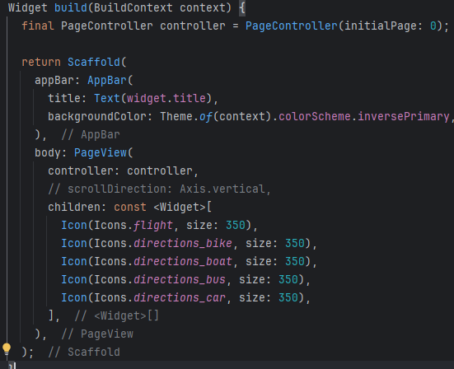
PageView (2)
the PageView needs a controller
  controller has optional initialpage
children is an array of widgets to swipe through.
  remember, you can get very complex set of widgets
  the example is very simple set of icons.

Slide 17
Bottom App Bar
the AppBar is at the bottom of the app.

Slide 18
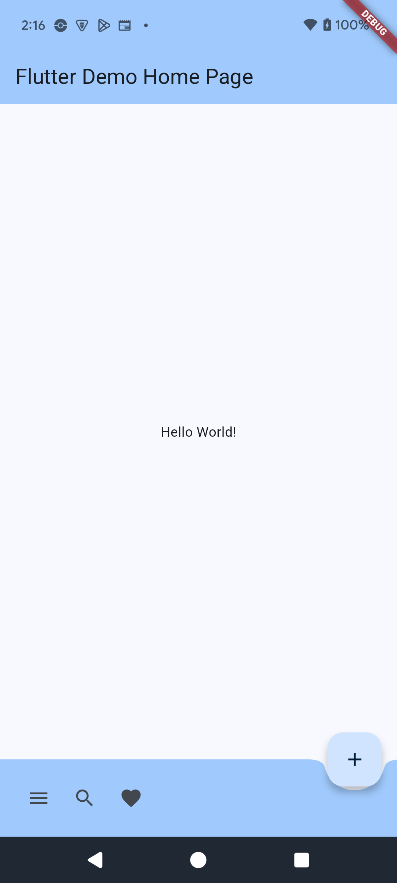
BottomAppBar
Not really a Route, but it fits better in this lecture.
using the bottomNavigationBar: in the scaffold
BottomAppBar( )
  if there is a floatingActionButton
  shape: CircularNotchedRectangle()
  Row of Icons, just like the top bar.

Slide 19
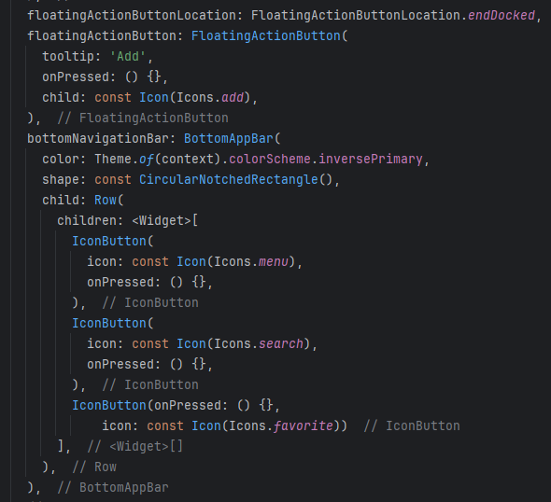
BottomAppBar (2)

Slide 20
references
https://api.flutter.dev/flutter/material/BottomAppBar-class.html
rail: https://www.youtube.com/watch?v=y9xchtVTtqQ
https://api.flutter.dev/flutter/widgets/PageView-class.html
https://api.flutter.dev/flutter/material/NavigationBar-class.html
https://api.flutter.dev/flutter/material/NavigationRail-class.html

Slide 21
Q
A
&

