Slide 1
Cosc 4735
Flutter
multiple screen, drawer, and tabs

Slide 2
multiple screen.
Routes

Slide 3
Multiple screens
Flutter uses the term routes, which same idea as express uses.
  Changing between 2 screens, in express two different pages, in android it's between activities.
  Remember, everything is Widget in flutter.
A route, is simply two different Widgets (Stateless or Stateful) that build a screen.
  Use the Navigator to change been routes.
    Navigator.push( …) to change to a new route
    Navigator.pop() to go back.

Slide 4
Routes
example
void main() {
runApp(
MaterialApp(
title: 'Navigation Basics',
home: FirstRoute(), //this is a widget.
)); }

Slide 5
Multiple screens (2)
class FirstRoute extends StatelessWidget {
@override
Widget build(BuildContext context) {
return Scaffold(
appBar: AppBar(
title: Text('First Route'),
),
body: Center(
child: RaisedButton(
child: Text('Open route'),
onPressed: () {
Navigator.push( context,
MaterialPageRoute(
builder: (context) => SecondRoute()),
);
},
), ), ); } }
class SecondRoute extends StatelessWidget {
@override
Widget build(BuildContext context) {
return Scaffold(
appBar: AppBar(
title: Text("Second Route"),
),
body: Center(
child: RaisedButton(
onPressed: () {
Navigator.pop(context);
},
child: Text('Go back!'),
), ), ); } }
note all this code is main.dart file
or can be in multiple files

Slide 6
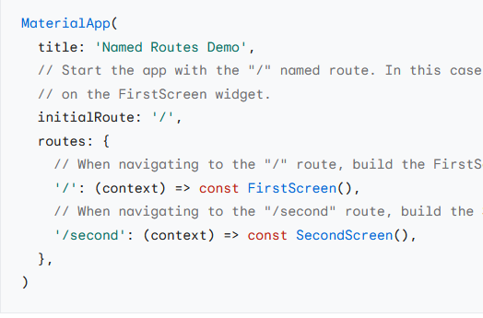
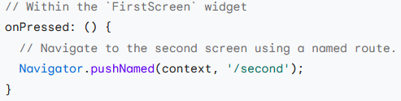
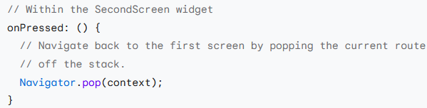
Named routes
Not recommend by flutter
  it looks a great deal like js and express
  default the routes app and then call it.

Slide 7
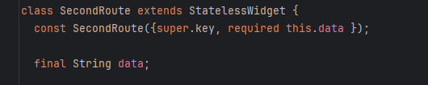
passing data to new route
This relatively easy. We are already passing key, and in the Title to main Screen, we can just add another variable (or more).
Call that screen, use the name for parameter.

Slide 8
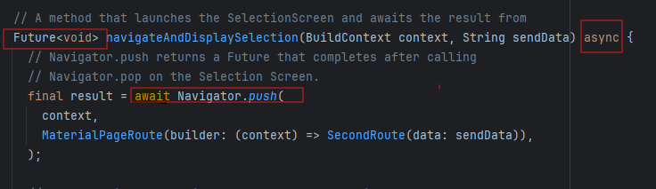

returning data from a route.
returning data is a little harder, only because it's async call to the screen and we don't know when it will come back. in Pop, add the variable to the call.
We need to declare function that is async and return in the Future
After the await, the data will be in result.
From the secondRoute, return with

Slide 9
NavigationDrawer

Slide 10
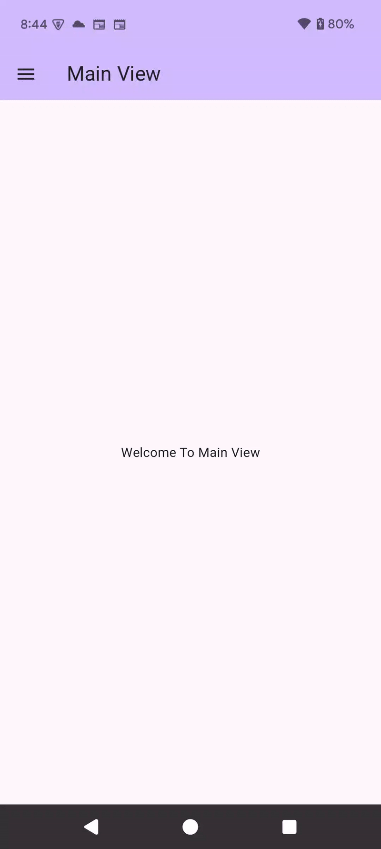
NavigationDrawer
The "drawer" slides out of the left or right side of the screen. The scaffold has spot for it
  drawer: (left side), endDrawer: (right side)
  note: m2 uses Drawer and listTiles
    m3 uses NavigationDrawer and DavigationDrawerDestination widgets.

Slide 11
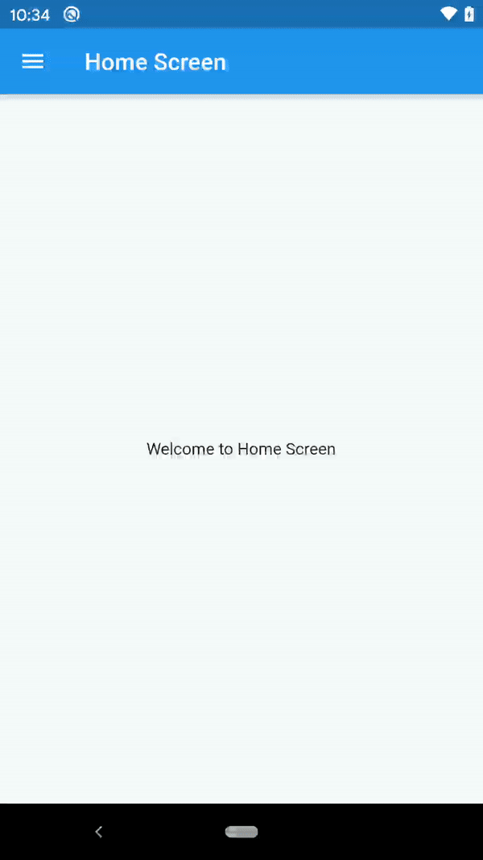
m2 vs m3
material design 3
material design 2

Slide 12
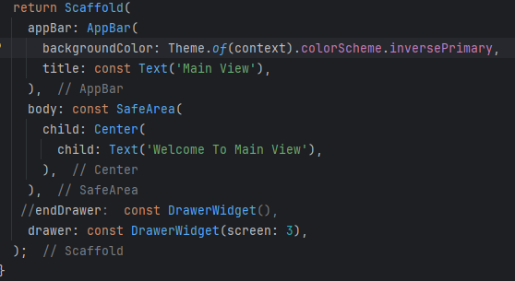
Navigation Drawer
The drawer is built into the scaffold
easy to use and create.
Scaffold(
drawer: NavagiationDrawer(…),
endDrawer: …
);

Slide 13
Drawers and multiple routes
If you want to use the drawer more like we would in android, where it changes between fragments, then it a little more complex.
  First put the drawer widget in its own class and likely own file
  put each router/screen also in itself file.
  define a routes class for each route.
    we have 4 screens, so 4 routes.
    using name routes, so the code is readable.
class routes {
static const String main = MainView.routeName;
static const String first = FirstView.routeName;
static const String second = SecondView.routeName;
static const String third = ThirdView.routeName;
}

Slide 14
main.dart
class MyApp extends StatelessWidget {
const MyApp({super.key});
// This widget is the root of your application.
@override
Widget build(BuildContext context) {
return MaterialApp(
title: 'Navigation Drawer Demo',
debugShowCheckedModeBanner: false,
theme: ThemeData(
primarySwatch: Colors.blue,
),
home: const MainView(),
routes: {
routes.main: (context) => MainView(),
routes.first: (context) => FirstView(),
routes.second: (context) => SecondView(),
routes.third: (context) => ThirdView(),
},
);
}
}
Main lists the routes
home: to display the first page
  just like normal.
  except in this case MainView() is in its own file.

Slide 15
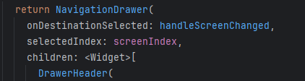
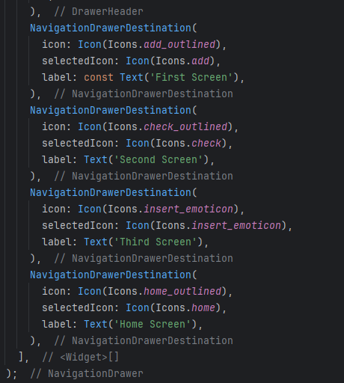
DrawerWidget()
The NavigationDrawer() widget
  normally you have a header and then items
    note the header is optional, but expected
    for space, left it off here, but see the code
  method to change the selection
  selectedIndex if you want it highlighted
  the header and then NavigationDrawerDestination

Slide 16
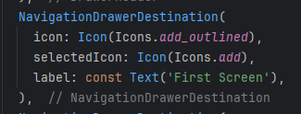
DrawerWidget() (2)
You are required to have a label and icon
  the selectedIcon is used when that item is selected.
  If you don't use the selectedIndex in NavigationDrawer, then you should also skip selectedIcon as well.

Slide 17
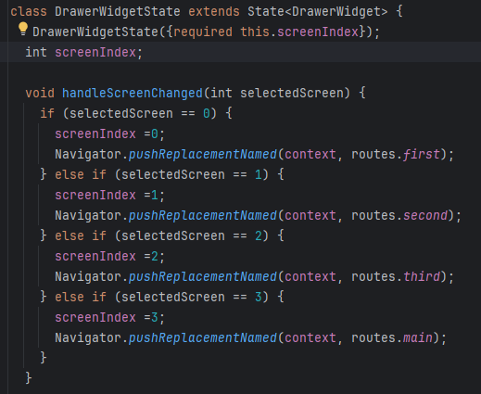
DrawerWidget() (3)
when the use selects a item, the handleScreenChanged method is called.
  or other method you use, specified by onDestinationSelected:
receives the number of the list.
note pushReplacementNamed is important here to remove the back buttom
  other use the Navigator push method.

Slide 18
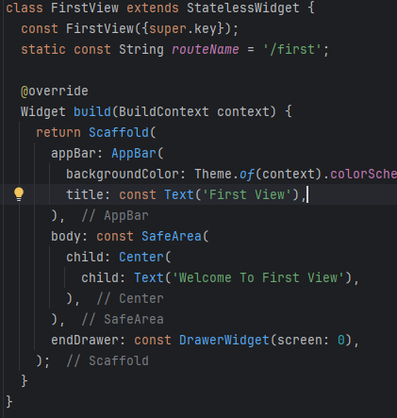
Example firstscreen.
in each "screen" you then have the drawer: with the widget

Slide 19
Visually.
This switches between views.
Here you get the same idea as fragments in android.
Note you can use the same technic with the NavigationRail and NavigationBar too.

Slide 20
TabBar and TabBarView

Slide 21
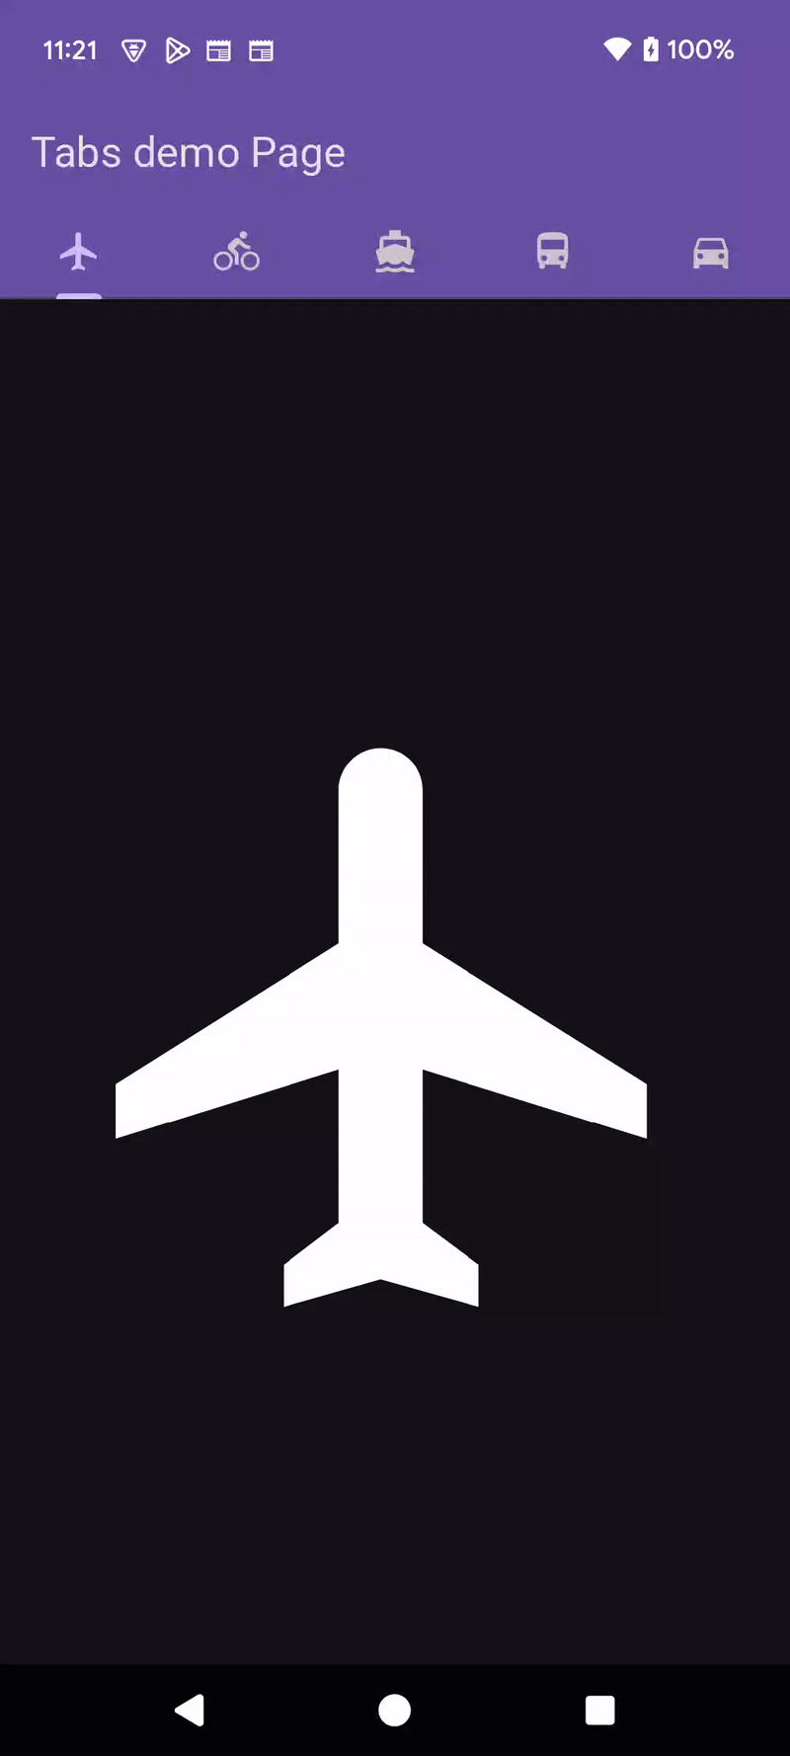
Tabs
Tabs give you a similar idea to a drawer
  except the label are on the top row and you can also swipe (left/right) or click the label/tab to change.
  In this example its much simpler than drawer, but you can do the same thing to get the tabs to change routes.

Slide 22
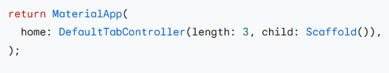
TabController
If the tabs will take up the whole space, then you can use a default controller
  otherwise, you need a separate tabController for the TabBar, which is added to TabView as well.
So, this uses all the space, note the Scaffold is a child.

Slide 23
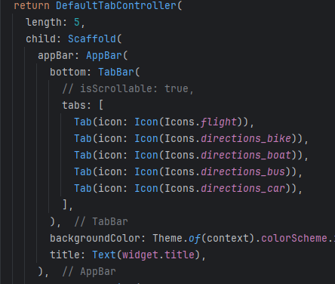
TabBar
The TabBar is top part with the AppBar
  it's a list of Icons in a Tabs:
    requires icon:
    optional text:
  since our length is 5, we need an array of 5 Tab.

Slide 24
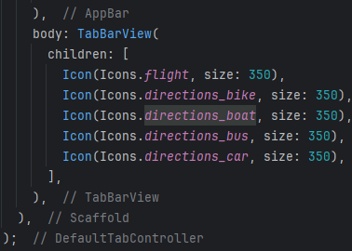
TabBarView
The TabBarView goes in the body
  again, it's an array of widgets with same size as the TabBar (ours is 5)
    You can get as complex with widgets (like a screen) as you need.
      in our case, just icons.

Slide 25
References
https://docs.flutter.dev/cookbook/navigation/named-routes
https://flutter.dev/docs/codelabs
https://docs.flutter.dev/cookbook/design/drawer
https://docs.flutter.dev/cookbook/design/tabs

Slide 26
Q
A
&

