Slide 1
cosc 4735
google maps and ads

Slide 2
Googe Maps
based on a code lab.

Slide 3
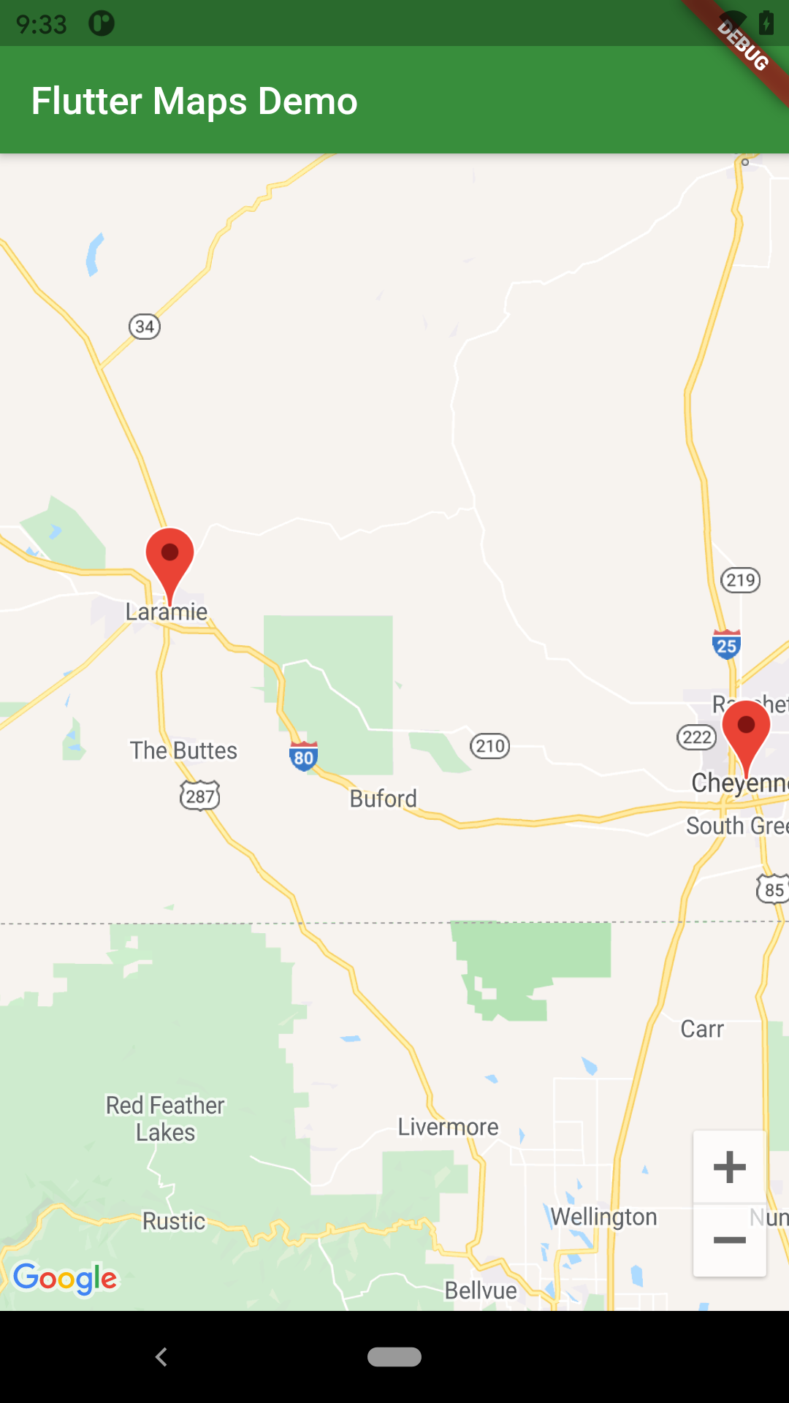
Google Maps.
This is very similar to how it is done in android.
  And we actually need to get a map key for android (and iOS as well)
  and put in the correct files, just like you would in android app.
    see the codelab reference at the end for key information.
  in the pubspec.yaml we need to add to the depencies.
    # Add the following line (or newer version, use pub outdated to check.)
    google_maps_flutter: ^2.2.5
OR command line: flutter pub add google_maps_flutter

Slide 4
Get the map.
In a stateful widget, but like android part of the map is coming via a thread (async)
you need a couple of pieces.
  the controller
  googleMap in the body.
a simple version
For markers set this
Future<void> _onMapCreated(GoogleMapController controller) async {
mapController = controller;
}
@override
Widget build(BuildContext context) {
return MaterialApp(
home: Scaffold(
appBar: AppBar(
title: const Text('Flutter Maps Demo'),
backgroundColor: Colors.green[700],
),
body: GoogleMap(
onMapCreated: _onMapCreated,
initialCameraPosition: const CameraPosition(
target: LARAMIE,
zoom: 11.0,
),
//markers: _markers.values.toSet(),
),
),
);
}

Slide 5
Get the map (2)
like android, we also have
onTap and onLongPress
And polygons, moves, camera, etc.

Slide 6
markers
To add markers to your map.
in the build GoogleMap
markers: List of markers.
then use the setState to add new markers.
final Map<String, Marker> _markers = {};
Future<void> _onMapCreated(GoogleMapController controller) async {
mapController = controller;
setState(() {
_markers.clear();
Marker laramieMarker = const Marker(
markerId: MarkerId("Laramie"),
position: LARAMIE,
infoWindow:
InfoWindow(title: "Laramie", snippet: "home of UW"));
_markers["Laramie"] = laramieMarker;
});
}

Slide 7
Examples
flutter_mapdemo give you the maps
  remember you need your own key to get it to work.

Slide 8
References
maps
  https://codelabs.developers.google.com/codelabs/google-maps-in-flutter#0

Slide 9
Q
A
&

