Slide 1
Cosc 4735
Alexia skills and blueprints

Slide 2
First thing.
You need an amazon developer account.
  This is also likely your main amazon account, but maybe separate. Or at least at some point my developer account appears to have merged, because it had different passwords
https://developer.amazon.com/
  Use the same email address you use to setup your amazon echo device
    That way it can be used with your developer account.
Note, while you can also created Alexa embedded devices, this lecture won't cover it.
  Such as on your raspberry PI device and many others.

Slide 3
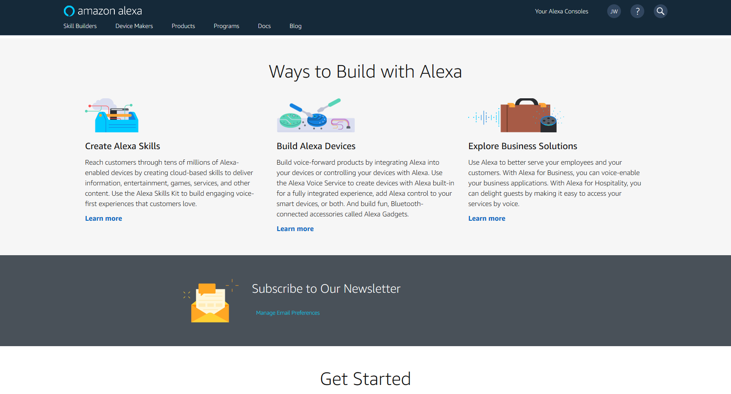
Alexa pages.
https://developer.amazon.com/alexa/

Slide 4
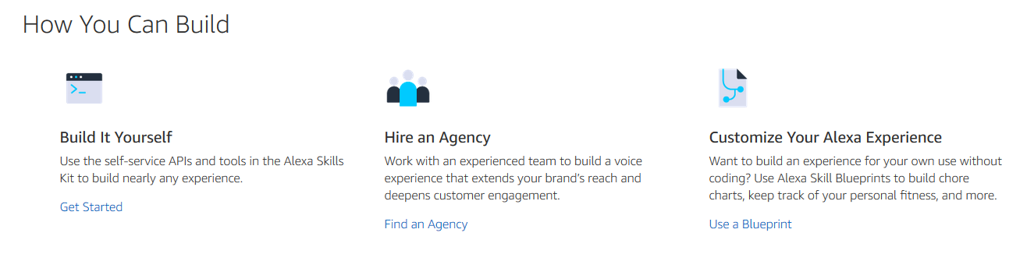
How to build skills.
https://developer.amazon.com/en-US/alexa/alexa-skills-kit

Slide 5
Blue Prints

Slide 6
Blueprint Template.
This are pretty simple and easy to build.
  https://blueprints.amazon.com/
Popular ones are the Houseguest template, roommate, and a simple Custom Q&A
We are going to use the houseguest template.
  All of them are similar in nature. Fill out answers to questions (add content)
    Then publish it. You can now publish generally, but normally you only publish these to your own devices.

Slide 7
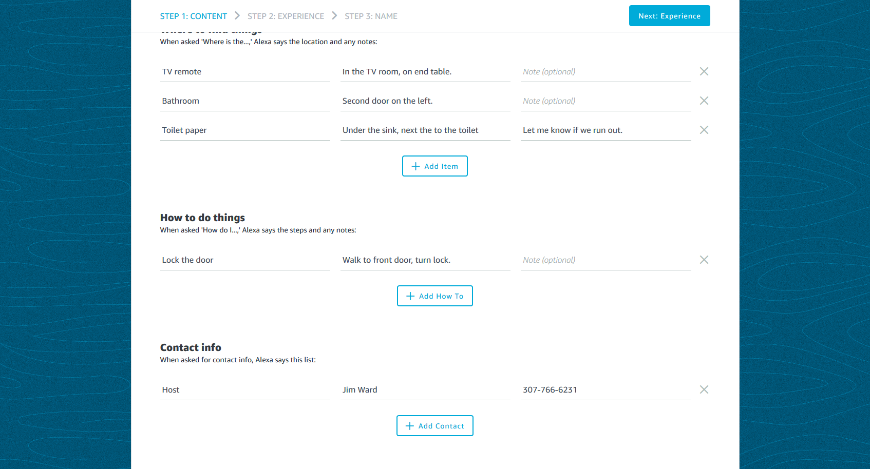
Example for content

Slide 8
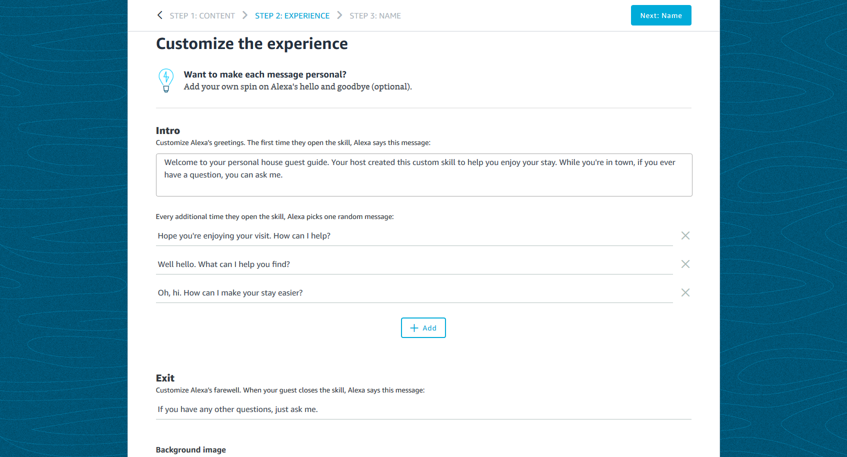
Example Experience

Slide 9
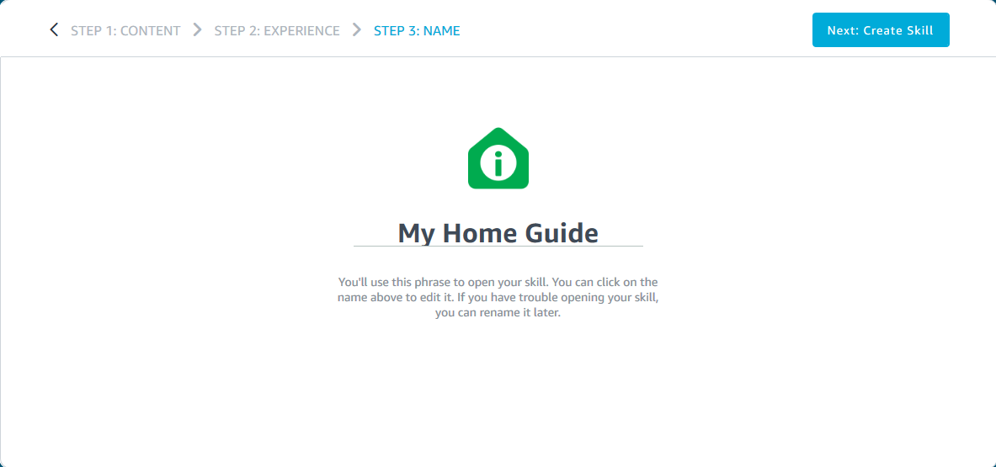
Example Name

Slide 10
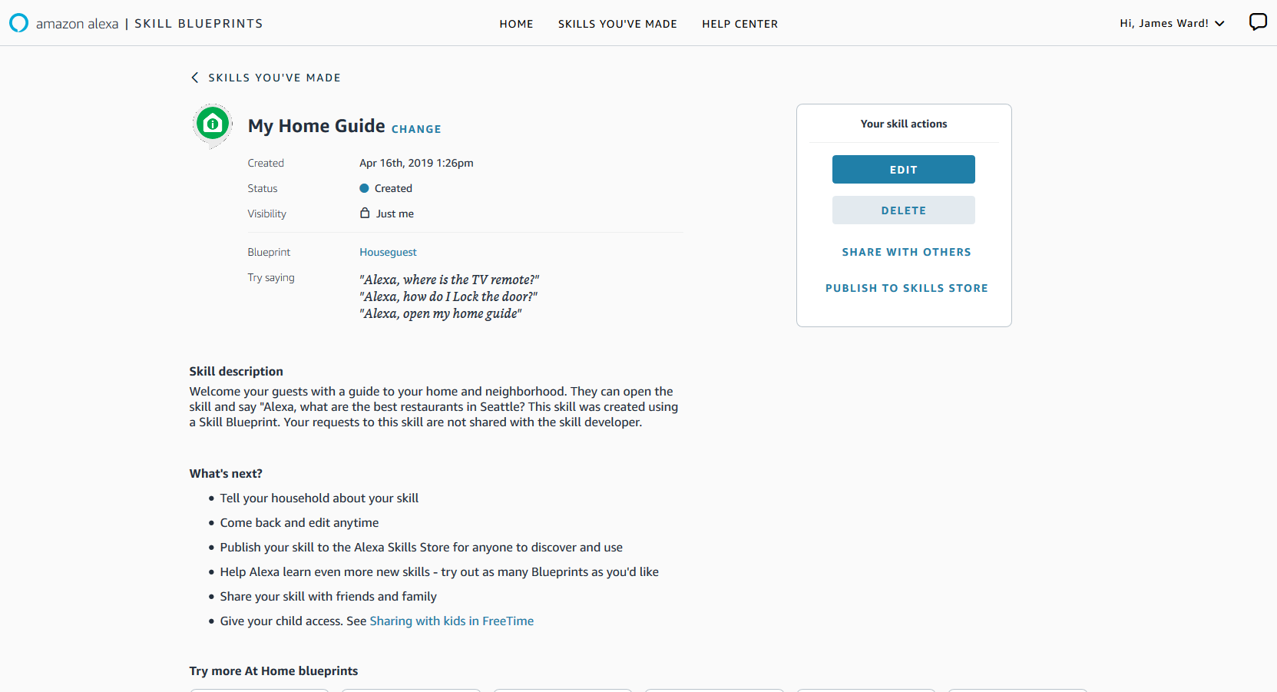
Wait for it complete and test it on your device.

Slide 11
Skills

Slide 12
Creating a skill.
https://developer.amazon.com/en-US/alexa/alexa-skills-kit/get-deeper/tutorials-code-samples/build-an-engaging-alexa-skill
  https://www.youtube.com/watch?v=FH9f98ARAU0 building a skill in under 2 minutes
  Building with node.js in 20 minutes https://www.youtube.com/watch?v=BB3wwxgqPOU
Click the create skill
  Name the skill
  Choose custom skill
  Choose alexa-hosthost by aws
  Click create skill (takes 1 to 5 minutes)

Slide 13
Creating a skill (2)
You have a basic hello world skill now.
In the Test, drop down, change development
  You can now test it in the simulator or on a echo device.
You can go the code section and add more
  It's all in Node.js
You will also need to add new intents for more actions.

Slide 14
References
https://developer.amazon.com/docs/ask-overviews/build-skills-with-the-alexa-skills-kit.html
https://developer.amazon.com/en-US/alexa/alexa-skills-kit/get-deeper/tutorials-code-samples/build-an-engaging-alexa-skill
https://www.youtube.com/channel/UCfY-LopSxGekh9LruXLjffg Dabble Lab, about 170+ video tutorials on Alexa skills.
https://developer.amazon.com/alexa-skills-kit/tutorials
https://developer.amazon.com/

Slide 15
Q
A
&

