Slide 1
Cosc 5/4730
Networking Overview and protocols

Slide 2
Basic networking
Networking coding is based on a client and server model.
Even if the code you are writing is not a client server model, like p2p code and others.
This is just enough to allow you write code and understand the terms.

Slide 3
Some quick definitions
Server: Offers it's services and "listens" for a request
Client: Requests services from a server by initiating a "connection" to the server.
Socket (refers both the Sockets API and a communication endpoint.). There are 2 kinds:
stream (SOCK_STREAM), which provide a bidirectional, sequenced, and reliable channel of communication
Used in major network applications
TCP connection
datagram (SOCK_DGRAM), which do not guarantee sequenced or reliable delivery, but are lightweight
Used as broadcast applications, and "steaming video/audio" applications
Think about as radio or TV
UDP connection
Port numbers are used to determine which program on a computer you want to talk to. Web servers usually use port 80, mail port 25, ftp port 23. RFC 1700 lists well know port numbers.

Slide 4
Writing Client code
The code requests a socket from the O/S
Specify: Internet or UNIX socket, TCP or UDP, and other flags for the socket.
Specify the remote host and remote port to use
Use functions to convert the name and port number for use by the O/S
And finally initiates a connection.

Slide 5
Writing Server code
Request a socket
Specify: Internet or UNIX socket, TCP or UDP, and other flags for the socket.
Now build up the socket address information
Specify port number and address allowed to connect. Most use INADDR_ANY, meaning any body can connect
Bind the address info to the socket
Establish a listen queue with the O/S for the socket.
Finally, the sever issues the accept command to accept a connection from a client.
The accept command can be used multiple times to accept more than one client (parallel connections or one after another.)

Slide 6
Once the socket has connected
The client and server communicate with each other using a protocol.
Protocol is defined syntax that both the client and server use
Similar in nature to human language, such an English
There are lots of protocols: ftp, httpd, telnet, smtp, and hundreds more.
Some protocols will specify multiple sockets to used at the same time, such as the FTP protocol.

Slide 7
Once finished
When the server and client have finished talking to each other
Both the client and the server will issue command to close the socket.

Slide 8
Communication
Sending information back and forth between two phones/devices
Once the connection has been created
We spend a lot next couple of lectures covering how those connections are opened, used, and closed.
It all about the protocol
IE how do they talk to each other.
Most network communication uses strings of text
SMS using a messaging object, since the information is delivered in a binary format.
Bluetooth can use string communication as well as a OBEX object.

Slide 9
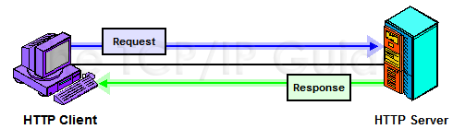
Protocol
This the type of messages and syntax of those methods are that sent.
Also defines what a response message (or set of messages sent back and forth) will be.
Example HTTP Protocol
Client make requests in HTTP request message format
Server responds, interpret, and return the relevant information in a HTTP Response message

Slide 10
HTTP Protocol
We take a brief and very limited look at the HTTP protocol
we mostly focus on version 1.0
The Android WebView hide of the details from the application.

Slide 11
HTTP Message format
HTTP message all fit a generic message format
Which is pretty close to SMTP message format using for email.
<start-line>
<message-headers>
<empty-line>
[<message-body>]
[<message-trailers>]

Slide 12
HTTP Message format (2)
Start-line is nature of the message
Normally a request or response message
Headers are all optional except one
In 1.1, the host header must be present
There are dozens of headers
Message body is optional
Since it mostly used by the server, but clients use it for errors messages
Message trailers are used for persistent connections
Mark where one message ends and the next begins.

Slide 13
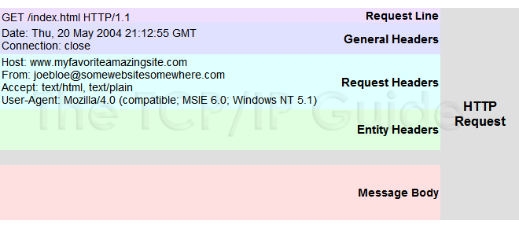
Request Message Example

Slide 14
Request message
start-line: Request line
<METHOD> <request-uri> <HTTP/version>
Method
Three common methods are GET, HEAD, POST
Request-uri
If the user was going to http://www.uwyo.edu:80/page.html
Then the request-uri is /page.html
GET /page.html HTTP/1.1
And the host header would be: HOST www.uwyo.edu:80
HTTP/version is
HTTP/0.9, HTTP/1.0, or HTTP/1.1

Slide 15
Request message (2)
Headers
General headers
Are about the message itself and are used to control processing or give extra info the server.
Request headers
Only in request messages
Give the server more information about the request and control for the client over how the request is handled.
Entity headers
Describe info in the body of the request, if any

Slide 16
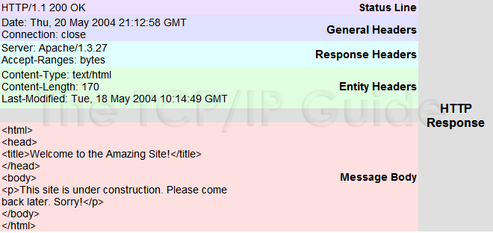
Response Message Example

Slide 17
Response Message
Start-line: Status line
<HTTP-Version> <status code> <reason-phrase>
HTTP-version, same as in request message
But the version the server can handle, if the request is for a higher version than the server users.
Status code and reason phrase
Results of request. The status code is a three digit code
We’ll get back to status codes later on.
You’ll find they are similar in nature to FTP codes.

Slide 18
Response message (2)
Headers
General headers
Are about the message itself and are used to control processing or give extra info the client.
Response headers
Only in response messages
Provide more information about the response. May contain more info about the body of the message.
Entity headers
Describes info in the body of message.

Slide 19
HTTP Methods
Get
Most general, get a resource to be returned to client
It functionality can be changed by headers, for caching (if-Modified-Since header) and many others
HEAD
Similar to get, only return header information, including entity header.
Server will not send the actual body of the message.
POST
Allows client the client to send a body message for processing by server (ie web forms and such)

Slide 20
FTP Protocol
The FTP Protocol is far more complex since it sends commands and responses back and forth.
Brief list of the command set
User, Pass, Acct, CWD, CDUP, SMT, REIN, QUIT, Port, PASV, TYPE, STRU, Mode, Retr, Stor, Stou, Appe, Allo, Rest, Rnfr, Rnto, Abor, Dele, Rmd, Mkd, Pwd, List, Nlst, Site, Syst, Stat, Help, Noop
Next slides are brief over of the protocol

Slide 21
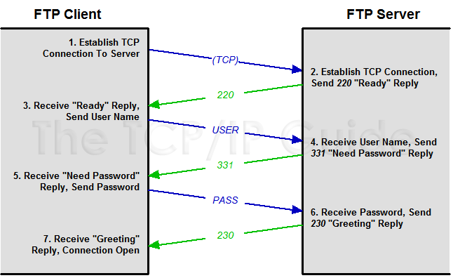
Connection Establishment

Slide 22
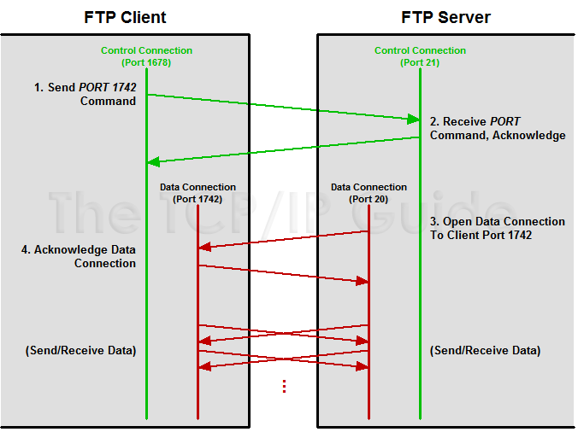
Normal (Active) data connection

Slide 23
SMTP Protocol
The e-mail protocol.
There are several versions.
The basic standard protocol is RFC 821, which we are going to look at.
Including some headers so standard mail reader understand the message better.
By default, the smtp server uses port 25

Slide 24
SMTP Protocol commands
SMTP is command based. The client issues a series of commands to the server.
Opening a connection. client opens port 25, then
client: HELO <client host name>
example: HELO laptop.cs.uwyo.edu
Server: 250 Ok [may contain extra info]
example: 250 alameda.cs.uwyo.edu HELLO laptop.cs.uwyo.edu [IP number], pleased to meet you

Slide 25
SMTP Protocol commands (2)
clients issues from command
MAIL FROM:<username@host>
example: MAIL FROM:<seker@cs.uwyo.edu>
server responses
250… sender ok
OR
5XX can't accept from sender.

Slide 26
SMTP Protocol commands (3)
Next, who the message is for
client:
RCPT TO:<username@host>
example: RCPT TO:<seker@cs.uwyo.edu>
server responses:
250 … Recipient ok
OR
5XX user unknown
The client can issue the RCPT command several times to send the same message to multiple addresses.

Slide 27
SMTP Protocol commands (4)
The data section, which were we enter to bulk of the mail message.
Client
data
server responses.
354 enter mail, end with "." on a line by itself
client
Enter message, headers, extra information, then enter period on a line by itself
example:
bah.. bah.. bah…
.

Slide 28
SMTP Protocol commands (5)
Server responses
250 … message accepted for delivery.
Finally, the client issues the quit command
quit
Server closes the connection.

Slide 29
smtp example
C: HELO laptop.cs.uwyo.edu
S: 250: HELO laptop
C: MAIL FROM:<seker@cs.uwyo.edu>
S: 250 ok
C: RCPT TO:<allyson@cs.uwyo.edu
S: 250 ok
C: Data
S: 354 …
C: blah… blah… blah…
C: etc….
C:.
S: 250 OK
C: quit
S: closing connection

Slide 30
smtp example (2)
From seker@uwyo.edu Mon Nov 3 19:10:47 2003
Return-Path: <seker@uwyo.edu>
Received: from localhost (localhost [127.0.0.1])
by meru.cs.uwyo.edu (SGI-8.12.5/8.12.5) with SMTP id hA42A4R7350019
for <seker@meru.cs.uwyo.edu>; Mon, 3 Nov 2003 19:10:41 -0700 (MST)
Date: Mon, 3 Nov 2003 19:10:04 -0700 (MST)
From: seker@uwyo.edu
Message-Id: <200311040210.hA42A4R7350019@meru.cs.uwyo.edu>
blah… blah… blah…
etc….

Slide 31
URL syntax
scheme://user:password@host:port/path;parameters
Where
scheme is the protocol (ie http, file, etc)
user is the username, which is optional
password is the password for the username, also optional
host is the fully qualified domain name or address
port is the optional port number, scheme provides the default
path is the path on the remote end
the format varies by scheme.
Parameters are optional parameters, depends on scheme.

Slide 32
Overview of networking.
In general network code will do the following
Client perspective:
Make a connection to the server
Send a “request/data” to the server
Wait for a response
Process the data.
If more data is needed go to 2.
Close the connection when finished.

Slide 33
More detail.
Sending and receiving data
When you read data, it is (normally) a blocking read.
So the program will stop until it has received data.
If the interface doesn’t need to respond, then this is not a problem.
Otherwise, we need threads.
Writing is NOT a blocking function. So when you write to a network socket, it will come back very quickly and the program will continue
Remember protocols though. Just because you can write, doesn’t mean you should write.

Slide 34
Threading read/writing.
In the case where a blocking read is a problem, we use threads.
Normally we create a reader thread.
The thread is a loop, which reads, processes data and then returns to top of loop.
The main thread will likely issue writes.

Slide 35
example
Main thread
Reader thread
After the connection is made, it starts the reader thread
It continues to respond to the user requests
Has a section of code that responds when it is signaled, when new data has been received
It would update the interface with the new data.
Android: think handlers!
While (true or !stop) {
Blocking read
process the data just read
More reads as necessary and process that data as well
signal the main thread we have received data.
}

Slide 36
Additionally.
Since we still must follow the protocol
The reader thread is the one that sets a variable for the writer.
If the protocol says the client must wait for the server to send data before the client can make another request
Then the reader thread sets a variable saying it is ok to write data now.
The main thread will always check that variable before issuing a write.

Slide 37
Another Option
In the previous example, the main thread had to check variable to determine when to write.
Another option is having the reader write at the bottom of the loop.
The main thread uses an array in which it adds data to it that is to be written but doesn’t issue a write.
The reader thread then removes the first item off the array, sends it, then goes back to read.
If the array is empty, it may have to wait for data or skip the write.
Now the reader thread ensures the protocol is followed correctly.
You will need locking and synchronization in order to make sure the “array” is access correctly by the main and reader thread.

Slide 38
Q
A
&

