Slide 1
cosc 5/4730
ListView and
ExpandableListView

Slide 2
A note
The Listview has been around since API version 1.
  It's simple to use but can also be very constrained.
  Android is recommending use of the RecyclerView instead of the ListView, we cover the RecyclerView in another lecture.
    You can do more interesting views and design.
  Both have their uses and failings.

Slide 3
ArrayAdapter
When we lists some type of "list" displayed, it uses an ArrayAdapter, which also needs a simple layout provided by android (don't need to create this layouts, unless you want to)
  andriod.R.layout.X for the layouts.
    http://developer.android.com/intl/zh-CN/reference/android/R.layout.html for the full list.
  This can be override to make very fancy views, with say icons and text, clickable ratings and text, etc…
    We will come back to this in ListViews

Slide 4
Spinner
A spinner needs "items" to fill the drop down box. This is done using an ArrayAdapter
  Using a string[] items, we can
  ArrayAdapter<String> adapter = new ArrayAdapter<String>(this,android.R.layout.simple_spinner_item, items);
  adapter.setDropDownViewResource(android.R.layout.simple_spinner_dropdown_item);
  Then use setAdapter(adapter); //fills the list
  Add listener, setOnItemSelectedListener(this)
    implement AdapterView.OnItemSelectedListener
      public void onItemSelected(AdapterView<?> parent, View view, int position, long id)
      public void onNothingSelected(AdapterView<?> parent)

Slide 5

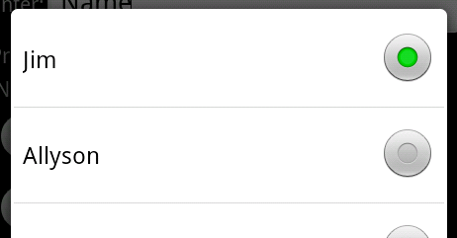
Spinner example
Closed Spinner (Drop down box)
Open Spinner

Slide 6
Spinner (2)
If instead, use an xml file with values
  res/values/
    <string-arry name="spinnerstuff">
      <item>Stuff</item><item>Stuff2</item>
    </string-array>
Change Adapter line to
  ArrayAdapter adapter = ArrayAdapter.createFromResource(
  this, R.array.spinnerstuff, android.R.layout.simple_spinner_item);

Slide 7
LISTview

Slide 8
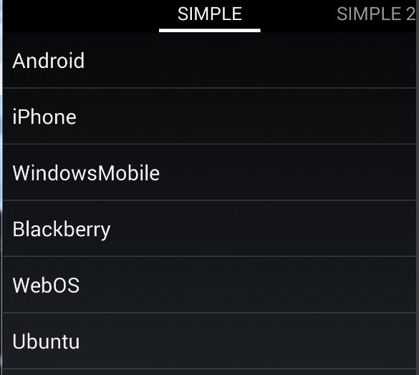
Listview (and spinner)
The spinner shown before is a very similar to a list view
A listView can be the only widget on the screen and can get very complex with the adapter.
  The items in the list are normally clickable.
Simple listView

Slide 9
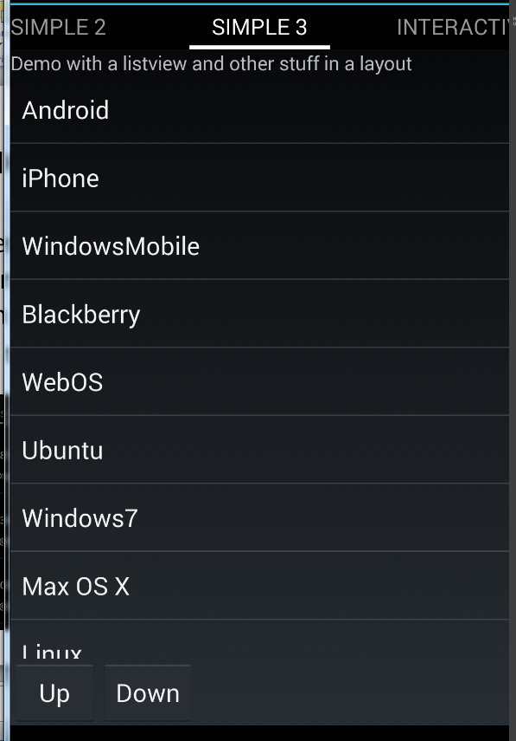
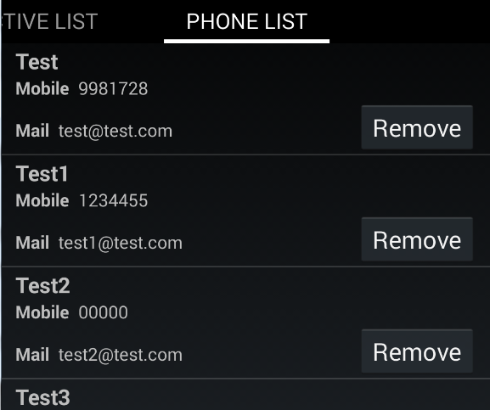
Listview continued
A listView can just be another widget in the layout as well.
Or a very complex, which multiple widgets in each item in the list
  Also true for the spinner

Slide 10
Listview and listFragment
There is a listfragment that can be used (also a listactivity too).
  It has a default layout which contains a listview.
  You use the setListAdapter(adapter) method
  And you override the OnListItemClick
Or you can just use a fragment, create the layout with a listview (and other views/widgets)
  And provide you own code to run the listview.

Slide 11
Simple listView
public class Simple extends ListFragment {
@Override
public void onActivityCreated(Bundle savedInstanceState) {
super.onActivityCreated(savedInstanceState);
// NOTE, there is no xml layout for this activity!
String[] values = new String[] { "Android", "iPhone", "WindowsMobile",
"Blackberry", "WebOS", "Ubuntu", "Windows7", "Max OS X", "Linux", "OS/2" };
ArrayAdapter<String> adapter = new ArrayAdapter<String>(requireActivity(),
android.R.layout.simple_list_item_1, values);
setListAdapter(adapter);
}
//This responses to the click event.
@Override
protected void onListItemClick(ListView l, View v, int position, long id) {
String item = (String) getListAdapter().getItem(position);
Toast.makeText(this, item + " selected", Toast.LENGTH_LONG).show();
}
}
The layout is how the items
will be displayed

Slide 12
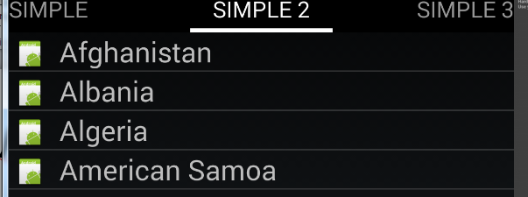
Changing the layout
ArrayAdapter<String> adapter = new ArrayAdapter<String>(requireActivity(), R.layout.rowlayout, R.id.label, values);
setListAdapter(adapter);
Uses a layout we created and the label is where the item is go. In this case with an picture.

Slide 13
rowlayout.xml
Using our custom layout, the listView displays an picture (the same picture for all items)
And we need a textview to display the “item” for each one. Which is called label in this case (you can choose whatever name).
<ImageView android:id="@+id/icon" android:layout_width="22dp"
android:layout_height="22dp" android:layout_marginLeft="4dp"
android:layout_marginRight="10dp" android:layout_marginTop="4dp"
android:src="@drawable/ic_launcher" >
</ImageView>
<TextView
android:id="@+id/label" android:layout_width="wrap_content"
android:layout_height="wrap_content"
android:text="@+id/label" android:textSize="20dp" >
</TextView>

Slide 14
More complex ListViews.
If you want to display more then one piece of information per item, then you can have not only change the layout, but extend the ArrayAdapter or BaseAdapter.

Slide 15
ArrayAdapter
The ArrayAdapter already extends the BaseAdapter and provides a lot of built in methods.
In the ListFragment (or Fragment) you would do something like this:
ArrayAdapter<Model> adapter = new InteractiveArrayAdapter(this, myModelList);
setListAdapter(adapter);
Where myModleList is a list<model>
  Where model is a class you created.

Slide 16
ArrayAdapter (2)
public class InterActive_myArrayAdapter extends ArrayAdapter<InterActive_DataModel> {
private final List<InterActive_DataModel> list;
private final Activity context;
InteractiveRowlayoutBinding binding;
public InterActive_myArrayAdapter(Activity context, List<InterActive_DataModel> list) {
super(context, R.layout.interactive_rowlayout, list);
this.context = context;
this.list = list;
}
@Override
public View getView(int position, View convertView, ViewGroup parent) {
//this will look very similar to onCreate or OnCreateView, using binding.
}
}

Slide 17
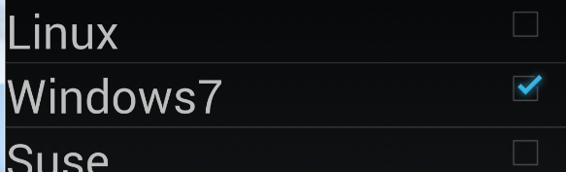
getView
So for this one, we have TextView and checkBox. The List tells us if it’s checked or not.
In getView, we create the View
if (convertView == null) {
binding = InteractiveRowlayoutBinding.inflate(context.getLayoutInflater());
} else {
binding = InteractiveRowlayoutBinding.bind(convertView);
}
binding.label.setText(list.get(position).getName());
binding.check.setChecked(list.get(position).isSelected());
binding.check.setOnCheckedChangeListener(new OnCheckedChangeListener() {
… see the code.
});
//Tag is an like a temp space, in a widget where you can set some information as an Object Class
//in this case, the position variable.
binding.check.setTag(String.valueOf(position)); //used to find the list position when we change the check mark
onBind = false; //end of setting data.
return binding.getRoot();

Slide 18
Custom ListViews
We want to very complex and provide our own interface, then normally we extend the baseAdapter to create “fragments” for each item in the ListView.
In this case a Phone class
is created to hold all the
Information, which passed
to an extended baseAdapter.

Slide 19
BaseAdapter
In a BaseAdapter you must implement the following methods:
public int getCount()
  How many items are in the data set represented by this Adapter.
public Object getItem(int position)
  Get the data item associated with the specified position in the data set.
public long getItemId(int position)
  Get the row id associated with the specified position in the list.
public View getView(int position, View convertView, ViewGroup parent)
  Like before, the view.
You will likely create a constructor, just like before, except you don’t call super, because they isn’t a super constructor.
  Get the list and context.

Slide 20
PhoneBookAdapter
public class Phonebook_myAdapter extends BaseAdapter implements OnClickListener {
private Context context;
private List<Phonebook_DataModel> listPhonebook;
PhonebookRowlayoutBinding binding;
public Phonebook_myAdapter(Context context, List<Phonebook_DataModel> listPhonebook) {
this.context = context;
this.listPhonebook = listPhonebook;
}
@Override
public int getCount() {
return listPhonebook.size();
}
@Override
public Object getItem(int position) {
return listPhonebook.get(position);
}
@Override
public long getItemId(int position) {
return position;
}
getView will be complex like before, with
the inflater and then setting up all the widgets
In the layout with information.
See the source code. ListDemo.zip

Slide 21
References
See the ListDemo on github in the lists repo.
There are a lot more to ListView
Also, you can do the same thing to a spinner as well. This allows you to create very complex “drop-down menu” to use in your app.

Slide 22
Listviews, fragments, and callbacks.
Also ModelView and LiveDATA

Slide 23
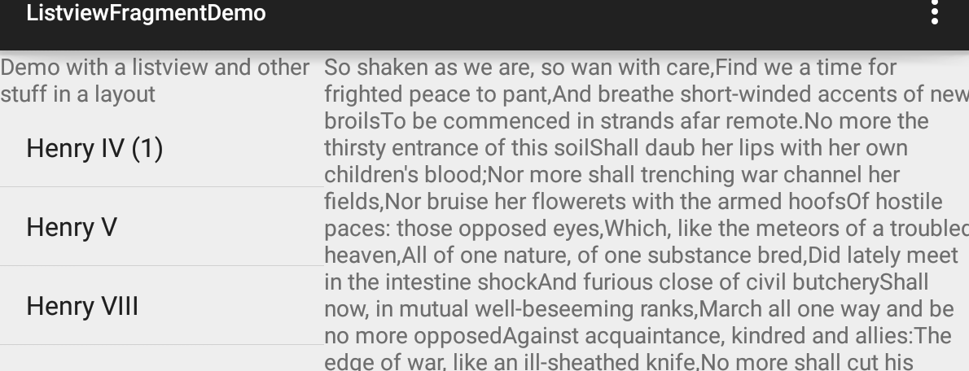
Frag com with listview.
Callback listener, via
the onItemClick methods
the Activity “sends” the information to the text fragment
OR
a modelview here and Observer here, when it's triggered, it changes the info
changes and triggers.

Slide 24
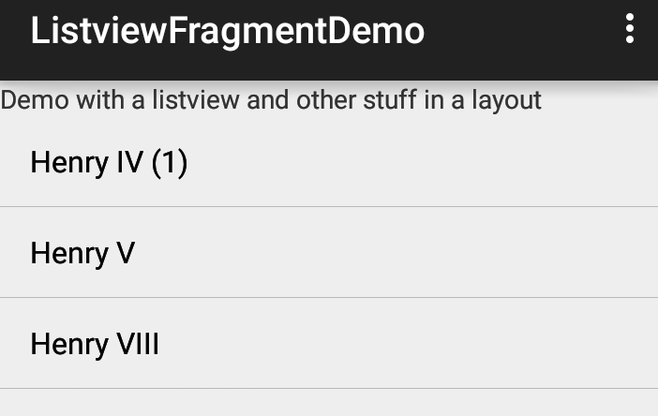

Frag com with listview (2)
Callback listener, via
the onItemClick methods
Since the text fragment is not on the screen, it adds it and sets the arguments to the fragment.
The fragment reads the position via
Get arguments, in the onStart()
method.
It then displays the correct info.
Pressing the back button, return to
listview again.

Slide 25
ModelView and LiveData with listview (2)
In the fragment there is a ModelView that has live data
When clicked, it changes the modelview. which triggers the observers.
This fragment sets observers for the
modelview. It then updates when it
changes.
Pressing the back button, return to
listview again.

Slide 26
ExpandableListView

Slide 27
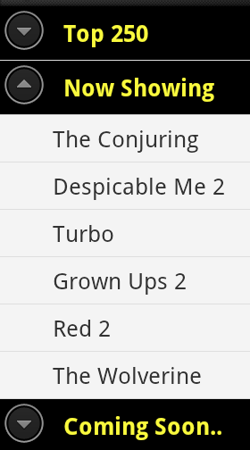
ExpandableListView
A view that shows items in a vertically scrolling two-level list.
  This differs from the ListView by allowing two levels: groups which can individually be expanded to show its children.
  The items come from the ExpandableListAdapter associated with this view.
Picture from
http://www.androidhive.info/2013/07/android-expandable-list-view-tutorial/

Slide 28
Layout(s)
The layout is just like a listview
  You can use it as the only widget or setup with other widgets.
  Basic version:
  <ExpandableListView
  android:id="@+id/lvExp"
  android:layout_height="match_parent"
  android:layout_width="match_parent"/>

Slide 29
Layouts (2)
Like a listview, you also need a layout for the items.
  Except now we have (likely) two layouts.
    Group heading layout
    Children layout

Slide 30
adapters
It should be noted there are several adapters you can use, subclasses of ExpandableListAdapter
  BaseExpandableListAdapter
    Which was extended for the elvdemo1
  SimpleExpandableListAdapter
    As the name says: simple. You provide with a list of items and a mapping for the layouts and it does the work. Or you can extend it to add even more. Which is used for elvdemo2
  CursorTreeAdapter, ResourceCursorTreeAdapter, SimpleCursorTreeAdapter
    Which can be used for databases or anything that has a cursor

Slide 31
SimpleExpandableListAdapter
It’s all about the constructor and the data.
  Which the data structure is a bit complex.
  The constuctor: SimpleExpandableListAdapter(
    Context context,
    List<? extends Map<String, ?>> groupData, //next slide.
    int groupLayout, //layout for group level
    String[] groupFrom, //mapping from the string key
    int[] groupTo, // to the data (in map<string,?>)
    List<? extends List<? extends Map<String, ?>>> childData, //ns
    int childLayout, //layout for the child level.
    String[] childFrom, //mapping from map string key
    int[] childTo) // to the data (in map<string, ?>)

Slide 32
The data.
We have to “lists” one for the group/parent level and another which is a list of lists for the child data.
List<? extends Map<String, ?>> groupData
  ArrayList<Map<String,String>> listDataGroup …;
    HashMap<String,String> m = new HashMap<String,String>();
    m.put( "Group Item","Group Item " + i );
      the key (Group Item) and it's value.
    listDataGroup.add( m );
List<? extends List<? extends Map<String, ?>>> childData
  In an nutshell, it’s a list of lists of Map data.
    There is a big list, that contains sublists (same number as items in groupData). The map items are the data for each child level.
      Again it uses the map<key, data> method. Which is mapped in the constructor.

Slide 33
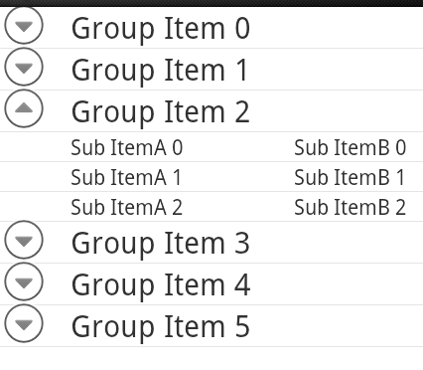
Resulting in something like this:

Slide 34
BaseExpandableListAdapter
This adapter you need to extend and then we get to implement all the necessary methods:
  getChild, getChildrenCount, getChildId, getChildView,
    All the list info for the children views
  getGroup, getGroupCount, getGroupId, getGroupView
    All the list info for the Group/parent views
  HastStableIds, and isChildSelectable
  Plus you’ll need a constructor for it as well.

Slide 35
BaseExpandableListAdapter (2)
Check the developer documentation and see the code for elvDemo1 for a better understanding what each of these methods are.
  Plus you really need to understand what a basic listview does!

Slide 36
Activity (old version)
Like the ListActivity, there is also a ExpandableListActivity
  Where you don’t have a layout for the main.
  It’s provided for you, plus some addition methods are built into the activity.
There doesn’t look to be a ExpandableListFragment (currently), so the examples use a Fragment and layout xml file.

Slide 37
References
http://www.androidhive.info/2013/07/android-expandable-list-view-tutorial/
http://www.coderzheaven.com/expandable-listview-android-simpleexpandablelistadapter-simple-example/
http://examples.javacodegeeks.com/android/core/ui/expandablelistview/android-expandablelistview-example/
http://theopentutorials.com/tutorials/android/listview/android-expandable-list-view-example/
http://learnandroideasily.blogspot.com/2013/07/android-expandablelistview-example.html
https://developer.android.com/reference/android/widget/BaseExpandableListAdapter.html
https://developer.android.com/reference/android/widget/ExpandableListView.html

Slide 38
Q
A
&

