Slide 1
Cosc 5/4730
Activities, fragments, callbacks/interfaces, and listeners
And now ModelView/LiveData

Slide 2
callbacks/interfaces, and listeners
old way.

Slide 3
Activity
It’s main code of the display
It can easy change between different fragments
Changing fragments from inside a fragment leads to “odd” behavior, avoid this.
Fragment
An encapsulated display and code to power it.
Including menus
How do I change a fragment then?
Using a callback/interface/listener google uses these interchangeably, even though are differences.
Or modelview with liveData!

Slide 4
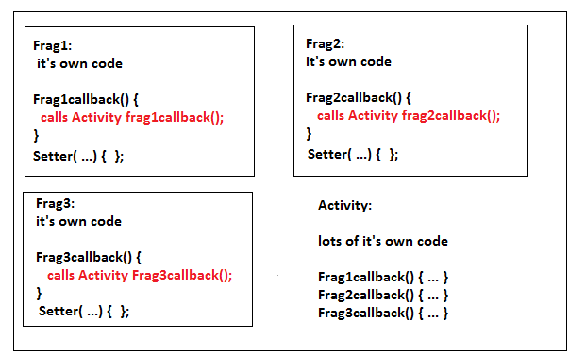
Frag1 will call Frag1callback() in the activity do actions such as changing fragments, adding information to a “global list”, updating another fragment.
Note, the setter for each allows another fragment to update information via the activity using a callback.
Note 2, you can have more then one callback. The activity just needs to implemented both.
And final Note, you can use the same name in the all three fragments (example: fragcallback() ) and then activity implements one ( same name fragcallback() ).

Slide 5
Callback/interface vs listener
A callback or interface must have an “implements X” otherwise it won’t compile or dies a runtime.
There is no default action
A listener can work without any extra code and the default action is taken.
Normally a default action is to do nothing.
A button for example has a default listener, which does nothing.

Slide 6
Interface/callback
Activity
public class MyActivity extends Activity implements myFragment.OnFragmentInteractionCallback {
…
@Override
public void onFragmentInteraction(String item) {
whatever code/action that are needed
}
} //end of activity
myFragment code
private OnFragmentInteractionCallback mCallback;
When the fragment calls the activity
if (mCallback != null) {
mCallback.onFragmentInteraction("0");
Setup mCallback
@Override
public void onAttach(Activity activity) {
mCallback = (OnFragmentInteractionCallback) activity;
}
@Override
public void onDetach() {
super.onDetach();
mCallback = null;
}
Interface and method(s) the activity must implement. In this case 1 method.
public interface OnFragmentInteractionCallback {
public void onFragmentInteraction(String list);
}

Slide 7
Listener
Activity
public class MyActivity extends Activity {
…
myFrag.setListner(new myFragment.OnFragmentInteractionLister() {
public void onFragmentInteraction(String item) {
// whatever code/action that are needed
}
}
} //end of activity
A note, The myFragment →
Could just use if (mListener != null) instead of the dummyListener.
myFragment code
private OnFragmentInteractionListener mListener;
In Constructor/onCreate
mListener = dummyListener; //uses dummylistener.
When the fragment calls the activity
mListener.onFragmentInteraction("0");
Set method to change the listener.
setListener(onFragmentInteractionListener listener) {
mLister = listener; //now uses activities listener.
}
Interface and method(s) the activity must implement. In this case 1 method.
public interface OnFragmentInteractionListener{
public void onFragmentInteraction(String list);
}
Dummy callback, so main is not required to do anything.
Private OnFragmentInteractionListenerdummyListener = new OnFragmentInteractionListener() {
public void onFragmentInteraction(String list) {
//do nothing
}

Slide 8
Callback/listener “hell”
Somethings to get back to activity, you may need a callback that uses a listener (or several nested)
Say getting from an adapter back to activity via a fragment.
This is code needed to get back from recyclerView adapter to the activity. Say when a user clicks a button.

Slide 9
Adapter code first
public class myRecyclerCursorAdapter extends CursorRecyclerAdapter<myRecyclerCursorAdapter.ViewHolder> {
// Define listener member variable for the adapter.
private OnItemClickListener listener;
// Define the listener interface
public interface OnItemClickListener {
void onItemClick(View itemView, String id);
}
// Define the method that allows the parent activity or fragment to define the listener
public void setOnItemClickListener(OnItemClickListener listener) {
this.listener = listener;
}
@Override
public ViewHolder onCreateViewHolder(ViewGroup parent, int viewType) {
View itemView = LayoutInflater.from(parent.getContext())
.inflate(R.layout.trans_row, parent, false);
ViewHolder vh = new ViewHolder(itemView, listener);
return vh;
}
public static class ViewHolder extends RecyclerView.ViewHolder {
public TextView mName; public Button btn;
public ViewHolder(View view,
final OnItemClickListener mlistener) {
super(view);
…
Btn.setOnClickListener(new View.OnClickListener() {
@Override
public void onClick(View v) {
// Triggers listner upwards to the adapter.
if (mlistener != null)
mlistener.onItemClick(v, mName.getTag().toString());
}
});
}
} //end of static class ViewHolder
}//end of class

Slide 10
Fragment and Activity Code
Fragment, skipping attach/detach code.
private OntransInteractionCallback mCallback;
myRecyclerCursorAdapter mAdapter;
In onCreateView
mAdapter.setOnItemClickListener(new myRecyclerCursorAdapter.OnItemClickListener() {
//remember this listener is going to the adapter
@Override
public void onItemClick(View view, String id) {
mCallback.ontransInteraction( …);
}
});
Rest of Fragment piece.
public interface OntransInteractionCallback {
public void ontransInteraction(Uri uri);
}
Activity
public class mActivity extends Activity implements myFragment. OntransInteractionCallback
Somewhere in the code:
@Override
public void ontransInteraction(…) {
//finally deal with the information from the adapter!
}

Slide 11
ModelView and liveData
new way.

Slide 12
First modelview and liveData
so can have something like this:
public class DataViewModel extends ViewModel {
private MutableLiveData<String> item = new MutableLiveData<String>();
… //lots of things as needed.
LiveData<String> getItemLD() { … return item; }
void setItem(String n) { item.setValue(n); }
}

Slide 13
Next
setup the recyclerview like normal. No need for listeners or callbacks.
Setup the adapter like normal with two changes (no listeners/callbacks needed)
First the constructor needs the fragment/activity info, so we can setup a the providers in the constructor.
mViewModel = new ViewModelProvider(requireActivity()).get(DataViewModel.class);
And the ViewHolder needs ViewModel passed to it (instead of a listener/callback).
public ViewHolder(View view, final DataViewModel mViewModel) {
in the onClick we call set.
some like this
mViewModel.setItem(mName.getTag().toString());

Slide 14
Now the easy part
Since the adapter triggers the observers!
MainActivity and/or fragments will be triggered to do things via the standard observer code.
in MainActivity it could change the fragment or something else.
In the Fragment, dialog box can easy be called.
we have escaped "Callback hell".

Slide 15
adapter and modelview/livedata
If you place an observer in the adapter, it will also be triggered.
it can then update the data in recyclerview.
This is the point of the observers
set the data in one place and everywhere else is notified.

Slide 16
And one last note.
combine this with the architecture navigation covered earlier
No more need for fragment transition managers.
Data is all passed along via the model view/live data.
Your code gets simpler and far easy to understand.
And hopefully easier for you to write as well.
We come back to "Data persistence" , observers make things so much easier.

Slide 17
Q
A
&

