Slide 1
Cosc 4730
Architecture and Retrofit2

Slide 2
What is retrofit2?
Retrofit is a type-safe HTTP client for Android and Java.
With Retrofit we can compose the HTTP connection easily through a simple expressive interface just like an api document.
By Square Inc.
A type-safe HTTP client for Android and Java
We can use retrofit2 for http ReST services and other http clients.
It can deserialize HTTP bodies into "OkHttp's" response.
Has converters for Gson (JSON), Jackson, Moshi, Protobuf, Wire, simple XML, and Scalars (ie strings/text, csv, etc).
Android Works ok with csv/text return, but far better with JSON (well formed anyway)

Slide 3
What is retrofit2?
We create a POJO to hold the returned data.
Setup a query interface (like the room DAO)
But we provide the controller implementation for the interface
And a onResponse code to the return http return.
A simple example is retrofit2Demo
Covered over the next couple of slides.
It gets the titles of the bugs for the eclipse project. The demo has not screen output, it goes to the logcat.

Slide 4
Using Retrofit
Api 24+
and requires java 1.8, so in your Android module build.gradle
android {
compileSdkVersion 30
…
compileOptions {
sourceCompatibility JavaVersion.VERSION_1_8
targetCompatibility JavaVersion.VERSION_1_8
}
}

Slide 5
retrofit2Demo
POJO
query interface
public interface GerritAPI { @GET("changes/") Call<List<Change>> loadChanges(@Query("q") String status); }
This tells it where to get the data, like room.
Look in the http://.../changes/
public class Change { String subject; public String getSubject() { return subject; } public void setSubject(String subject) { this.subject = subject; } }

Slide 6
Controller code
public class Controller implements Callback<List<Change>> {
static final String BASE_URL = "https://git.eclipse.org/r/";
public void start() {
Gson gson = new GsonBuilder() .setLenient()
.create();
Retrofit retrofit = new Retrofit.Builder()
.baseUrl(BASE_URL)
.addConverterFactory(GsonConverterFactory.create(gson))
.build();
GerritAPI gerritAPI = retrofit.create(GerritAPI.class);
Call<List<Change>> call = gerritAPI.loadChanges("status:open");
call.enqueue(this); //kickstart the whole process
}
@Override
public void onResponse(Call<List<Change>> call, Response<List<Change>> response) {
if (response.isSuccessful()) {
List<Change> changesList = response.body();
for (Change stuff : changesList)
Log.d("HI", stuff.getSubject());
} else {
System.out.println(response.errorBody());
}
}
@Override
public void onFailure(Call<List<Change>> call, Throwable t) {
t.printStackTrace();
}

Slide 7
"Main Code"
Remember, network is on a thread, so this is runs in the background and is likely launched from the MainActivity or fragment
Controller controller = new Controller();
controller.start();
Now it goes out and gets the data on a background thread.

Slide 8
Used with LiveData
Since this is networking, we don't know when the response will come back.
Setup to use with LiveData/ViewModels and observer
Now when the data has been processed the UI will be updated.
Example of liveData with Retrofit2
Retrofit2LiveDataDemo
Note this requires a website, the php code and database is provided in the php directory of the project.

Slide 9
Pulling this all together, plus FCM
A battery killer is polling on a networking for new data.
So we can use LiveData/ViewModel with a room database to store local data (cache basically).
Display that initially as when the app starts up
Call for an update via retrofit2, which would be used to update the database
Maybe even paging on DAO so we don't overload the device when the update comes in.
Except none of that fixes polling.
Add in Firebase Cloud Messaging into the mix. The app registers to receive an update message.

Slide 10
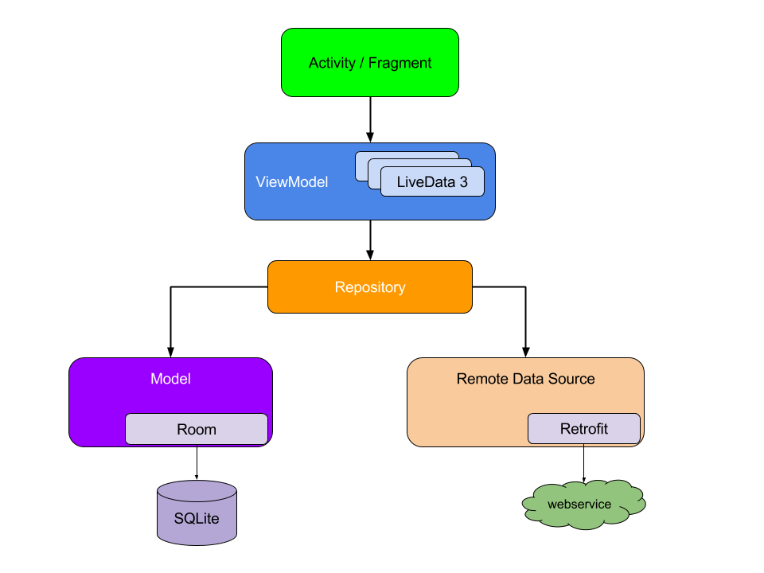

Slide 11
Pulling this all together, plus FCM (2)
FCM messages will be received even when the app is not loaded.
So…
If the app is running, make a retrofit2 call to update the room db.
If the app is not running, set a "status" to update.
When the app launch, if the status says to update, then it makes a retrofit2 call
Else we can no skip the update when the app launches as well.
As note, this can also take the cause the average load on a server to go down, but the peak load will now be high when data changes.
But depends on how often data changes as well.
This is what the FcmRetrofit2LiveDataDemo does.

Slide 12
References
http://square.github.io/retrofit/
http://www.vogella.com/tutorials/Retrofit/article.html
https://medium.com/@jintin/retrofit-2-b0c80d5caadf

Slide 13
Q
A
&

